Slide 2
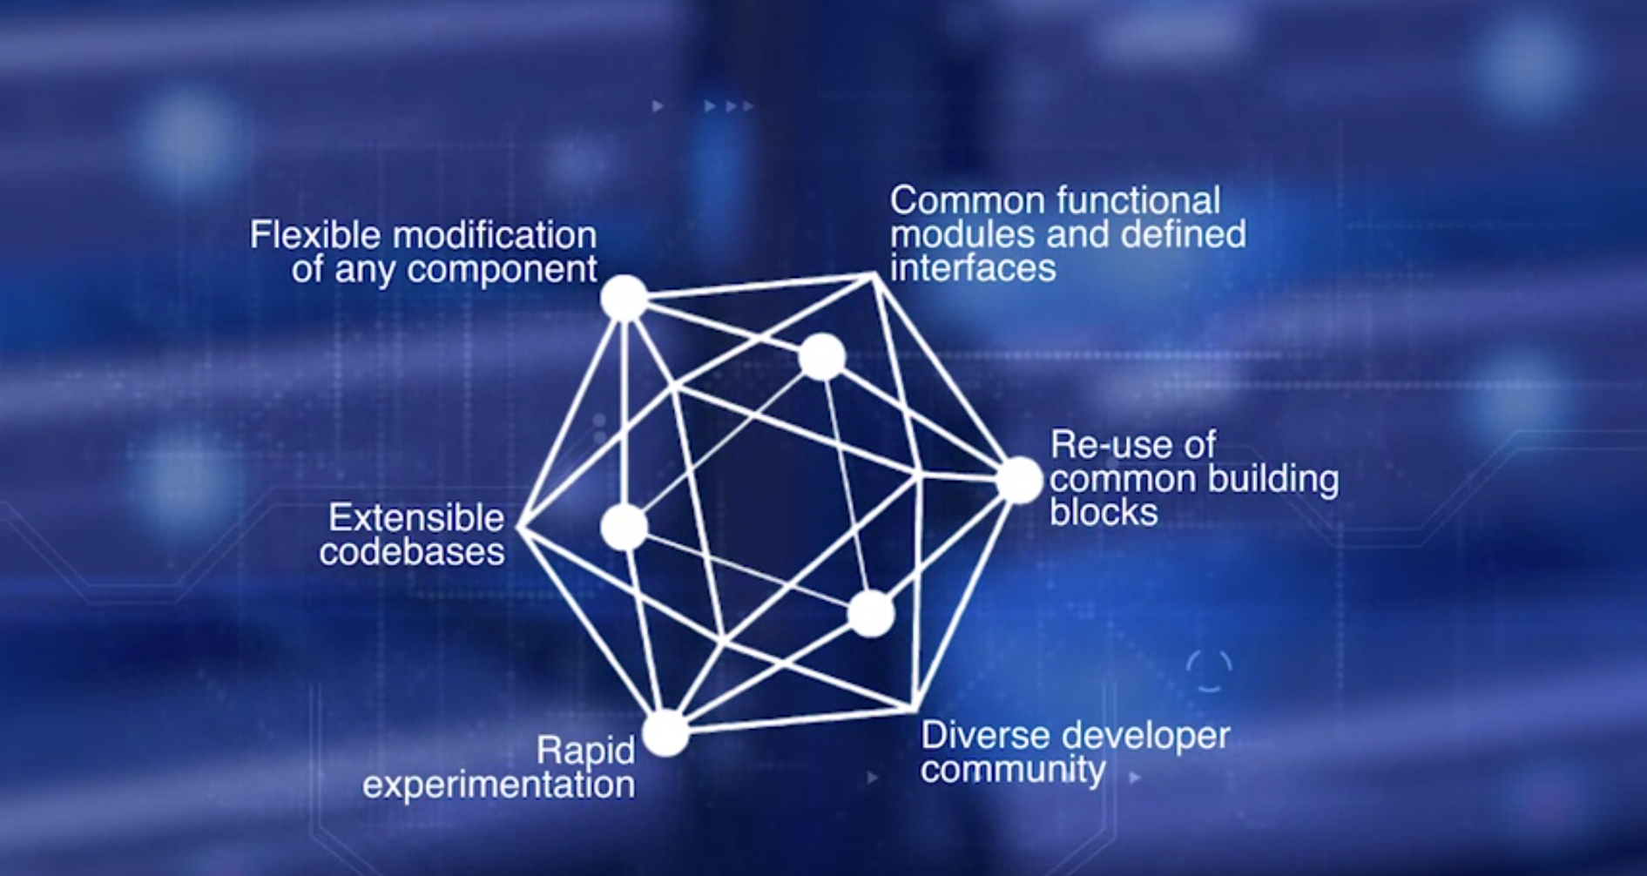
Course 4: Week1
The five frameworks are Fabric,
Sawtooth, Indy, Iroha, and Burrows,
all incubated by the Hyperledger framework.
Tools are essential for rapid prototyping and testing,
and four tools are in incubation, Cello, Quilt, Composer, and Explorer.

Slide 3
Course 4: Week1
Recall that Bitcoin protocol defined the transactions of a blockchain in terms of UTXOs, Unspent Transaction Outputs. An Ethereum protocol introduces smart contract and the concept of an account.
The Hyperledger Fabric goes further than this in defining a whole business network with roles and assets and aligning the protocol closer to real-world application.
Note that Hyperledger Fabric 1.0 is the only production framework out of The Linux Foundation at this time.

Slide 4
Course 4: Week1
Let's explore significant differences between Bitcoin, Ethereum, and Hyperledger.
In Hyperledger protocol there is no cryptocurrency.
Hyperledger is designed for handling only business logic, such as the smart contract functionality.
The smart contract code is called chaincode in Hyperledger.
An even more significant difference between Bitcoin and Hyperledger is that Fabric is a permissioned blockchain, and unknown peers cannot join and leave the network as they wish.
Hyperledger aims to architect solutions for business to business,
business to customer, rather than any unknown, trustless, decentralized peers.
Mining of the blocks is also significantly different since only designated validating peers will undertake this operation in Hyperledger.
This feature helps in the implementation of the consensus algorithm PBFT, Practical Byzantine Fault Tolerance, versus proof of work of Bitcoin blockchain.

Slide 5
Course 4: Week1
Let's explore significant differences between Bitcoin, Ethereum, and Hyperledger.
In Hyperledger protocol there is no cryptocurrency.
Hyperledger is designed for handling only business logic, such as the smart contract functionality.
The smart contract code is called chaincode in Hyperledger.
An even more significant difference between Bitcoin and Hyperledger is that Fabric is a permissioned blockchain, and unknown peers cannot join and leave the network as they wish.
Hyperledger aims to architect solutions for business to business,
business to customer, rather than any unknown, trustless, decentralized peers.
Mining of the blocks is also significantly different since only designated validating peers will undertake this operation in Hyperledger.
This feature helps in the implementation of the consensus algorithm PBFT, Practical Byzantine Fault Tolerance, versus proof of work of Bitcoin blockchain.

Slide 6
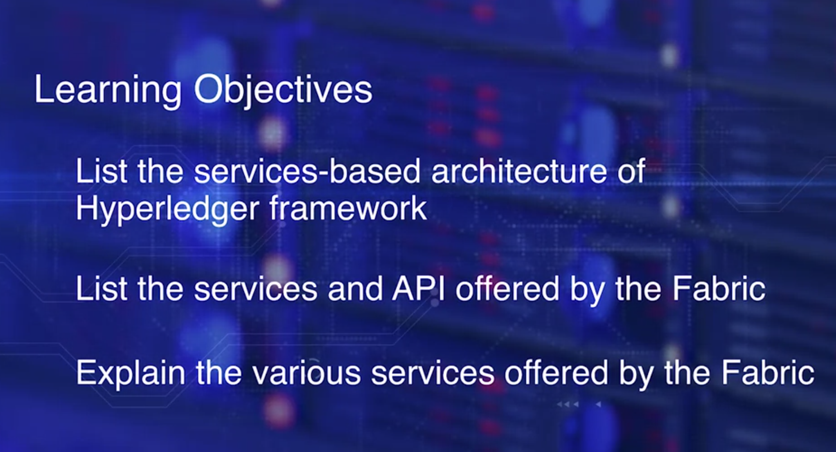
Course 4: Week1

Slide 7
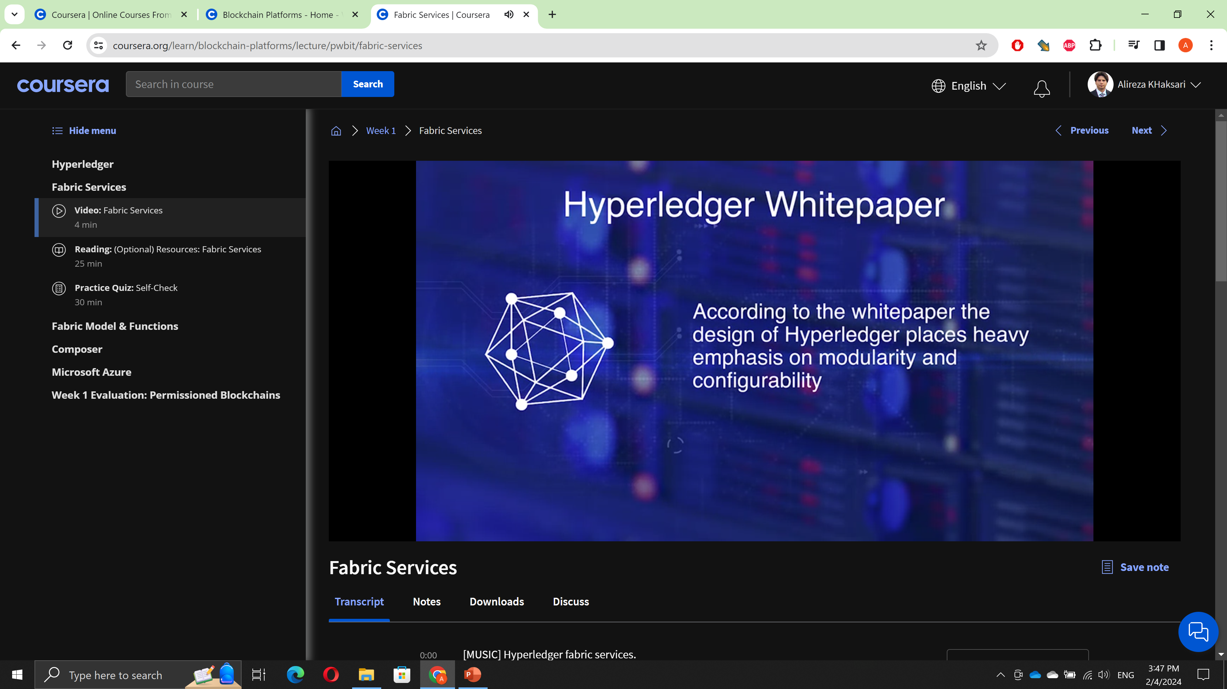
Course 4: Week1

Slide 8
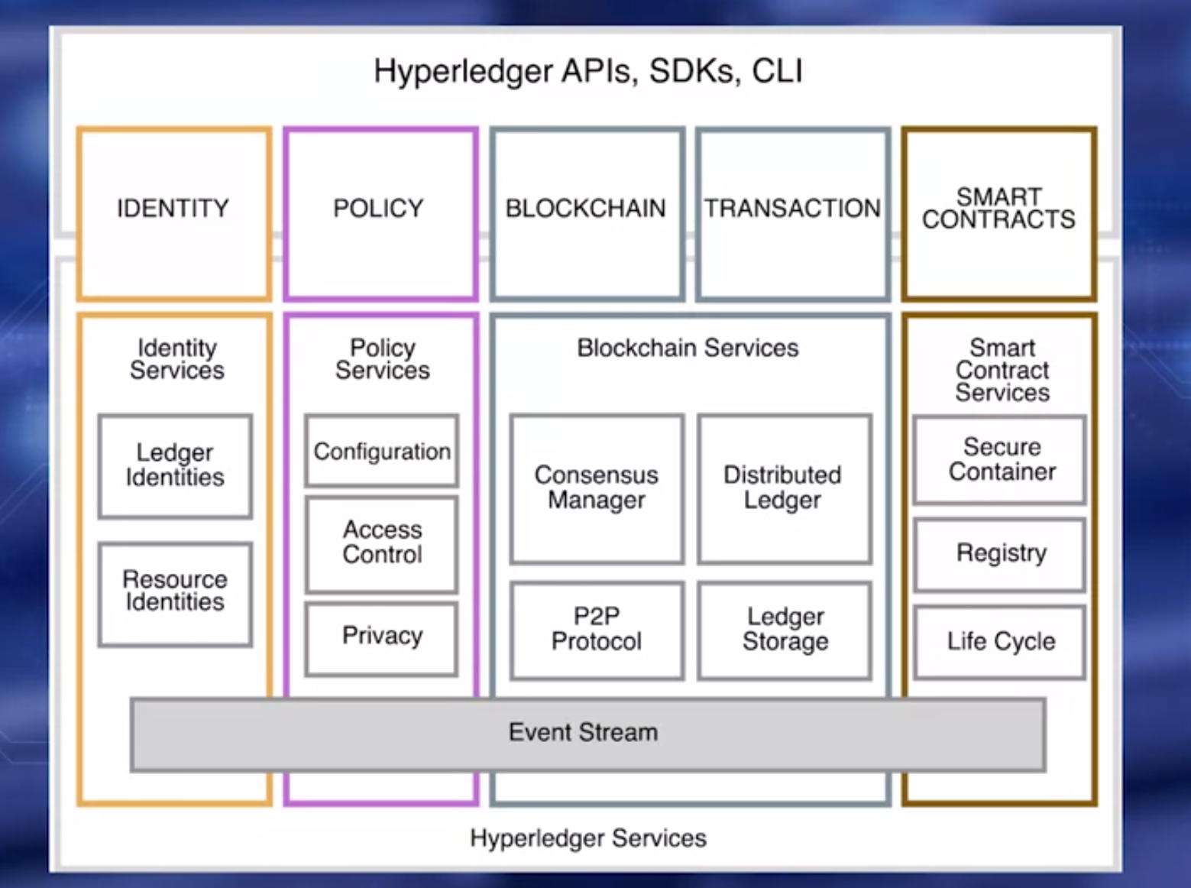
Course 4: Week1
The reference architecture specifies four different groups of services and
the corresponding APIs for the applications to access them.

Slide 9
Course 4: Week1
The reference architecture specifies four different groups of services and the corresponding APIs for the applications to access them.
In the case of fabric, a smart contract is called chain code.
Policy services module manages access control, privacy detail, consortium rules and consensus rules.
Blockchain services module manages the peer-to-peer communication protocol, the distributed ledger maintaining the global state, the global state replicated at many participants, the plugable consensus algorithm, PBFT or POW. The smart contract services module provide a secure and lightweight sandbox and moment for the chain code to execute.
Only full nodes call the validating nodes include the smart contract services.
This service also provides the secure container equivalent to Ethereum virtual machine, registry, and life cycle management functions.
Java virtual machine that runs bytecode typically serves as a computational environment for the smart contract execution.
APIs allow application programs to call into the underlying services. SDKs help encode development based on these APIs.

Slide 10
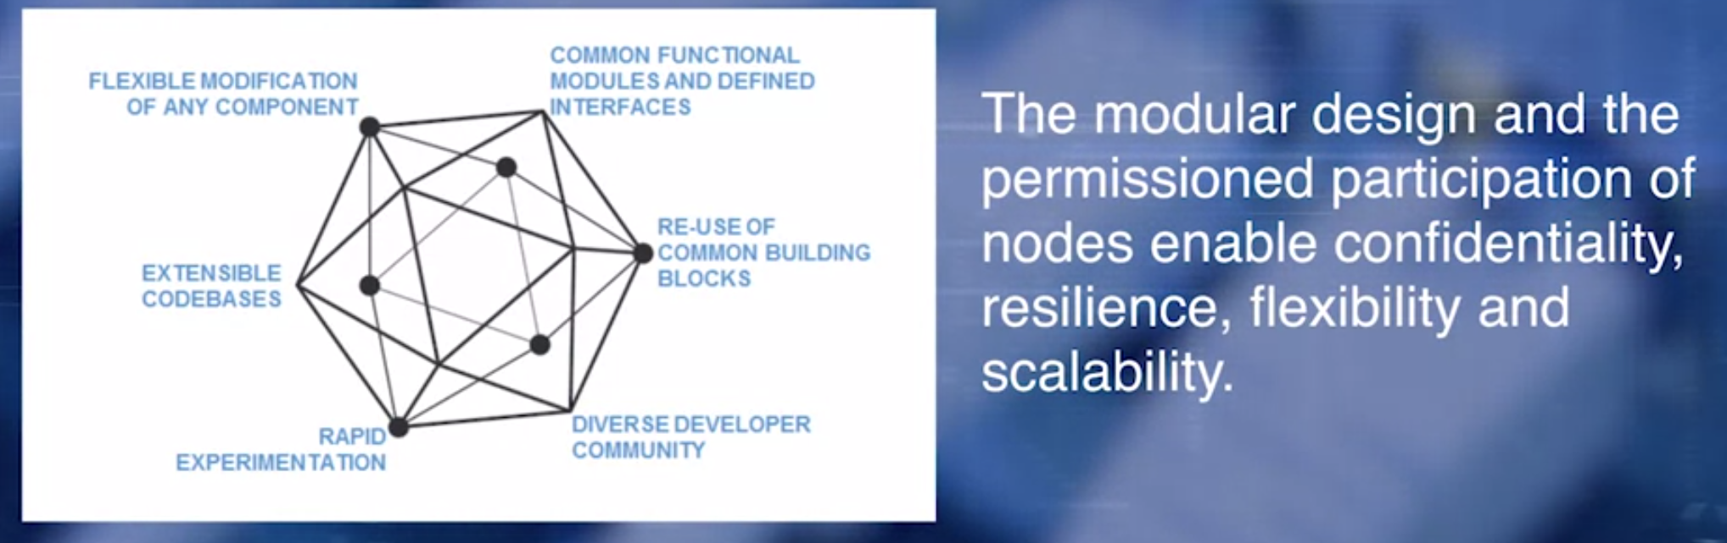
Course 4: Week1 Fabric Model & Functions

Slide 11
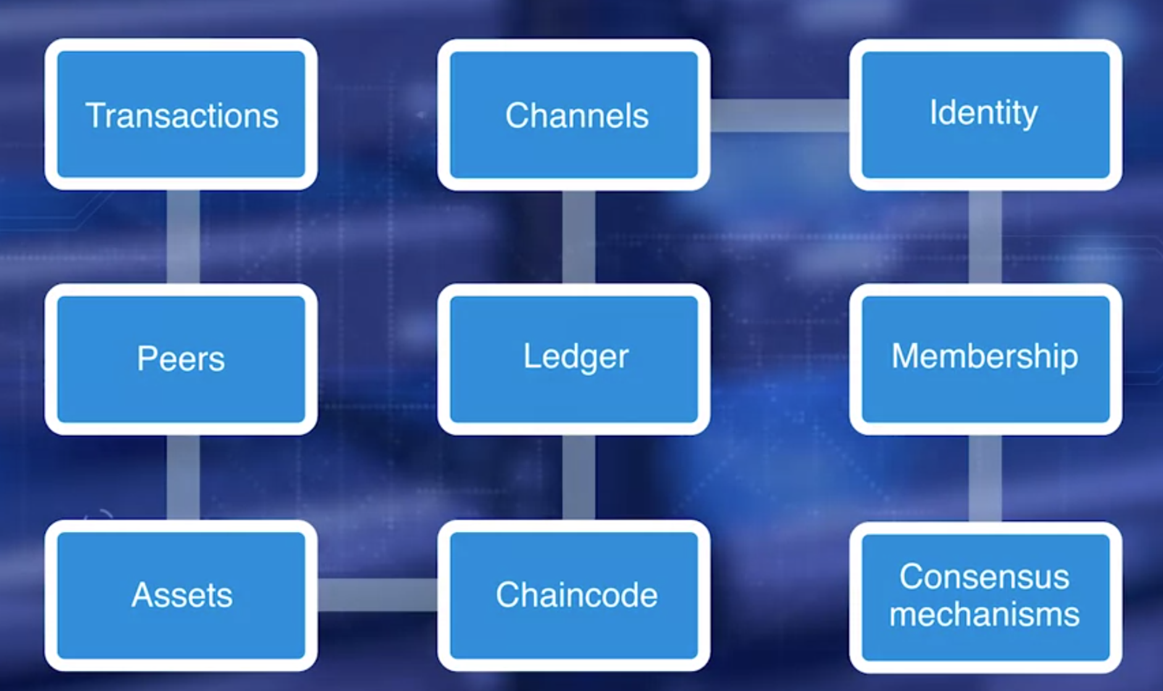
Course 4: Week1 Fabric Model & Functions
Let's explore the details.
On completion of this lesson,
you will be able to explain fabric model and its functionality.

Slide 12
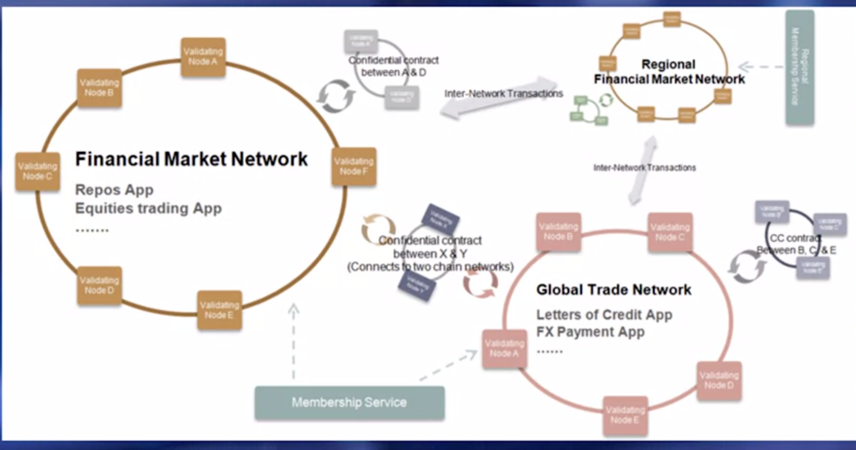
Course 4: Week1 Fabric Model & Functions
You see, multiple business blockchains each with its own channel, with its
validating nodes, membership services for identity and membership management.
Interactions between different independent business networks are enabled by
confidential smart contracts.
Transaction could be inside a single network or cross network.
We'll now examine the various components in detail.

Slide 13
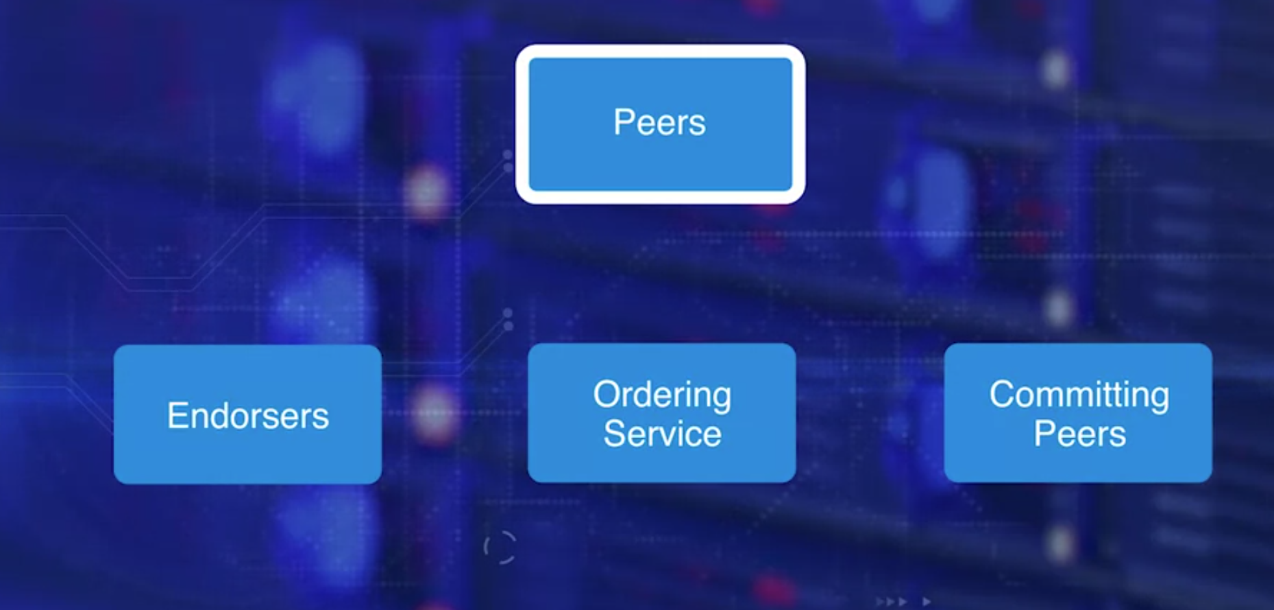
Course 4: Week1 Fabric Model & Functions
There are three types of peer nodes.
Endorsing peers, receive and validate transactions,
sign them, and return them to the creating application.
Ordering peers collects signed transaction,
ordered them into blocks and send them to committing peers. This is also known as the ordering service.
Committing peers receive the blocks created by the ordering service. Validate condition such as double spending and signature and then commit them to the ledger.

Slide 14
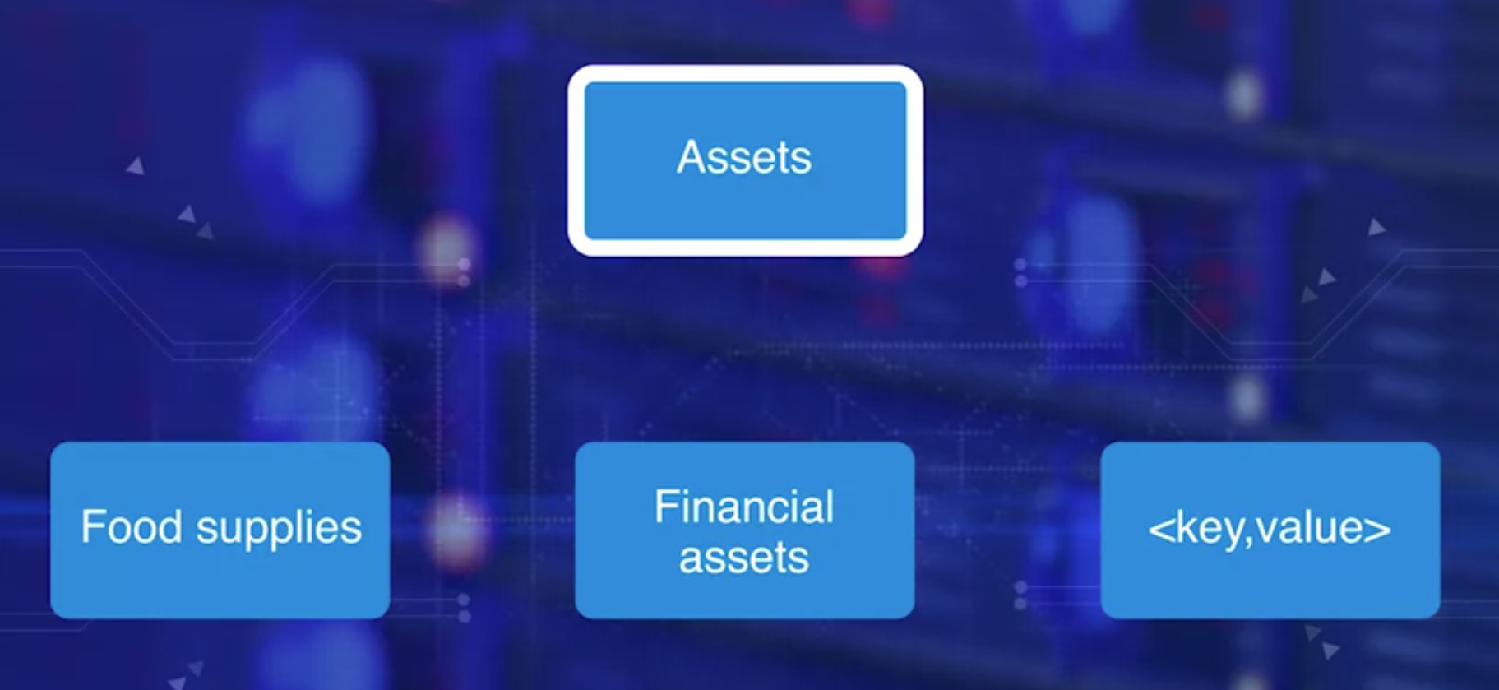
Course 4: Week1 Fabric Model & Functions
Assets represent the tangible items of value that are transacted in the blockchain, for example, food supply and financial assets.
Assets are represented in the program as key value pairs in JSON on binary format.

Slide 15
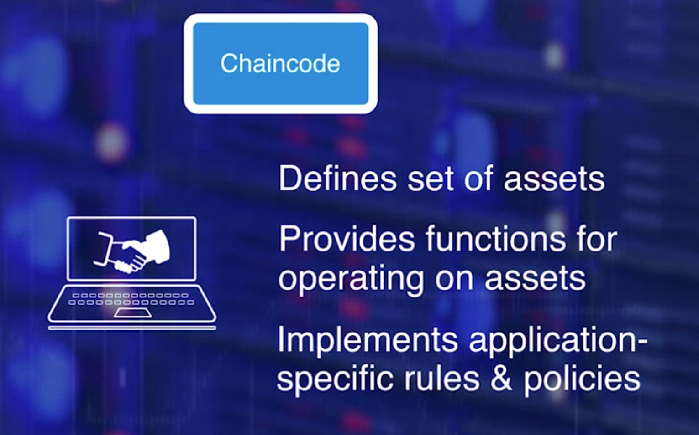
Course 4: Week1 Fabric Model & Functions
Chaincode is a smart contract that defines a set of assets and provides the functions for operating on the assets and changing the states.
It also implements application-specific rules and policies.

Slide 16
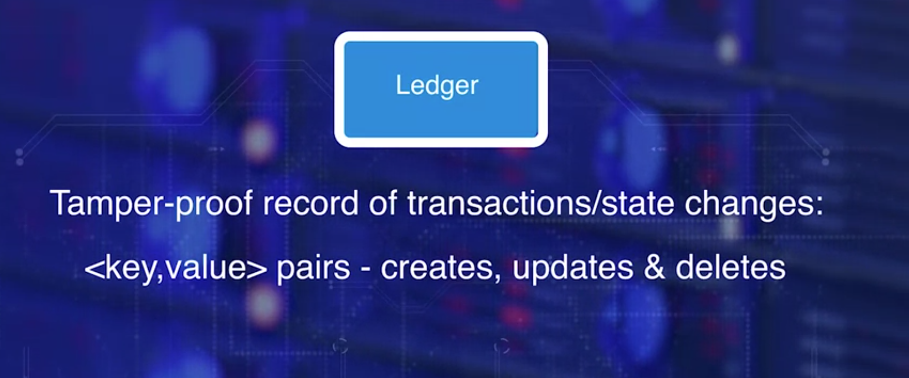
Course 4: Week1 Fabric Model & Functions
The ledger is similar to other blockchain ledgers
it is a tamper proof record of state transactions in the fabric.
State changes are effected by the in vocations of chain code functions by the transactions initiated by participants on the fabric.
Transactions assigned and all the access control rules
set by the permission services are enforced for
a transaction to be executed and included in a block for recording.
Each transaction results in a set of asset pairs that are recorded on the ledger as creates updates and deletes.
Since a ledger is a key value store, it can be easily queried for later analysis and auditing Another element of the Fabric model is channels.

Slide 17
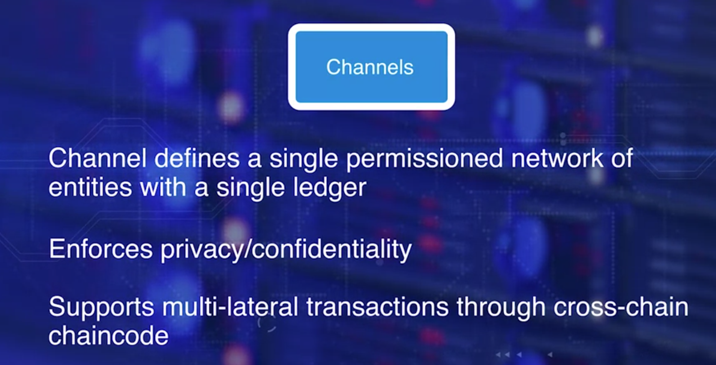
Course 4: Week1 Fabric Model & Functions
Fabric enforces privacy and confidentiality through the channel concept.
Channel defines a single permissioned network of entities with one single ledger for all its transactions and state changes.
Channel provides segregated fabric for a group of entities to transact privately. Even within the channel, the data and transaction confidentiality can be achieved by out for skating and by using cryptographic methods.
Channels also provide the ability to support multi-lateral
transactions among competing businesses and
regulated industries through cross-chain chaincode.
In this case, each private business consortium operates on its own private network with cross-chain transaction controlled by policies implemented in the chain code.

Slide 18
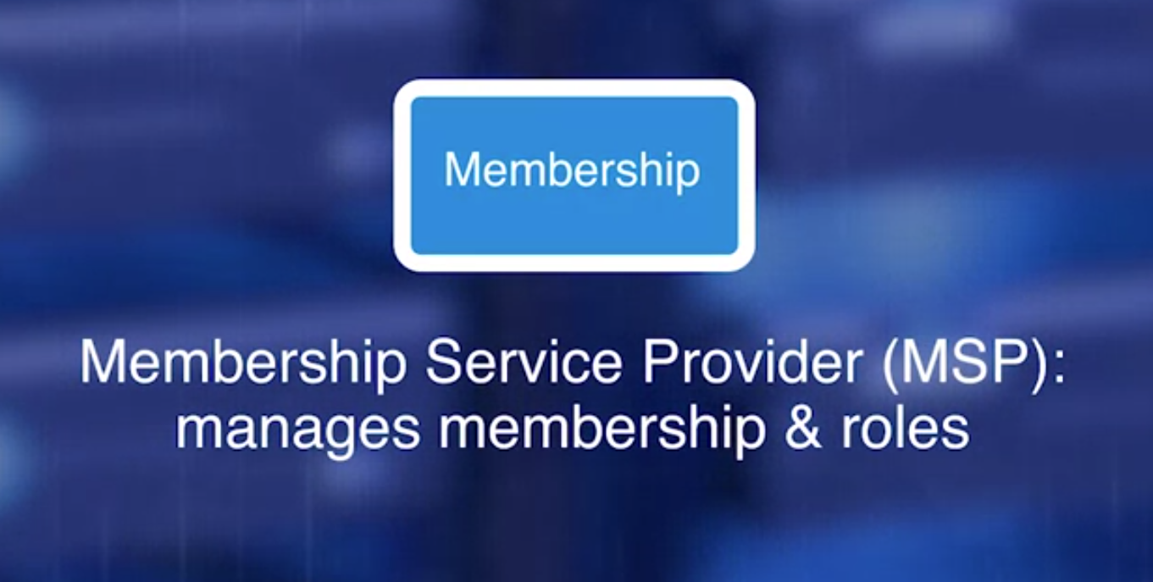
Course 4: Week1 Fabric Model & Functions
Entities wanting to participate in a Fabric network,
enroll through a trusted Membership Service Provider or MSP.
An organization manages its membership,
and the roles of the participating entities through an MSP.

Slide 19
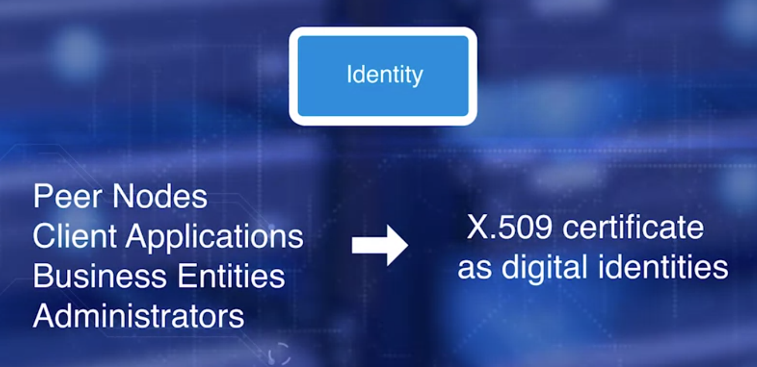
Course 4: Week1 Fabric Model & Functions
Participating entities should have verifiable identity.
For realizing trust, the default implementation of
MSP uses a X.509 certificate as a digital identity.
The peer nodes, client application, business entities,
and administrators need uniform identities in the Fabric.
Each are assigned an identity that is an X.509 certificate.
These identities determine the role of the entities,
and the permissions they have for accessing the resources in the blockchain network.

Slide 20
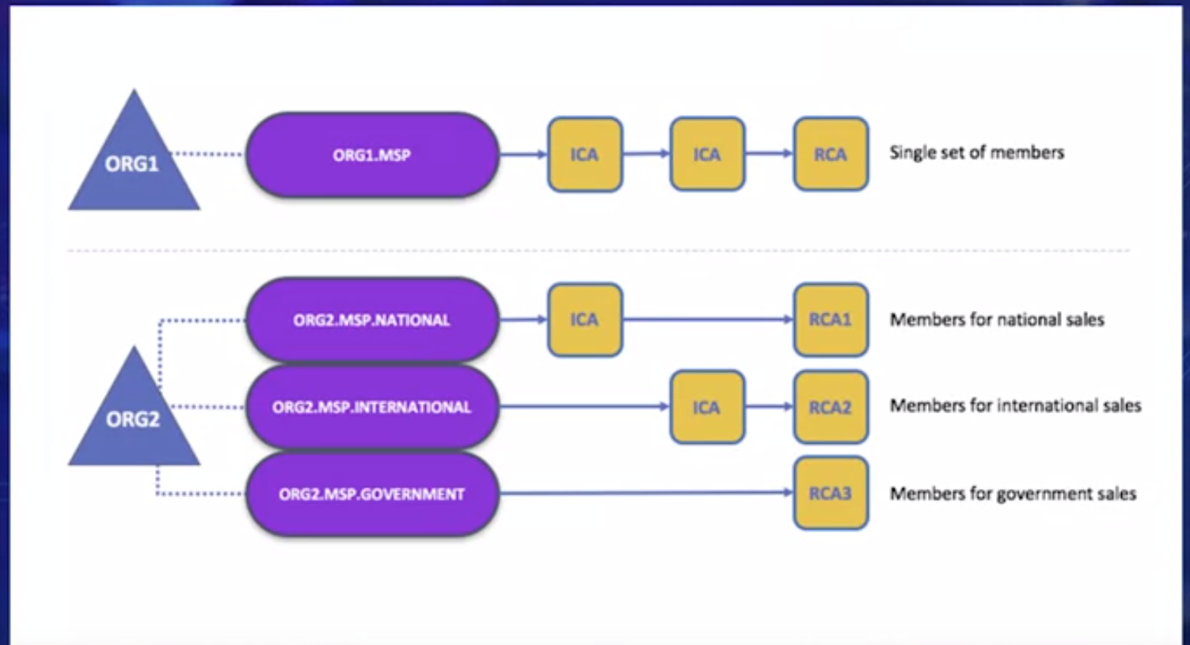
Course 4: Week1 Fabric Model & Functions
This leads us to the next question: Who in MSP assigns them identities?
There is a root certificate authority and intermediate certificate authorities managed by the MSP.
Here you see two organization. ORG1 does not have any sub-organizations. ORG2 has two sub-organization, each with root certificate authority and intermediate certificate authorities providing identity certificates.

Slide 21
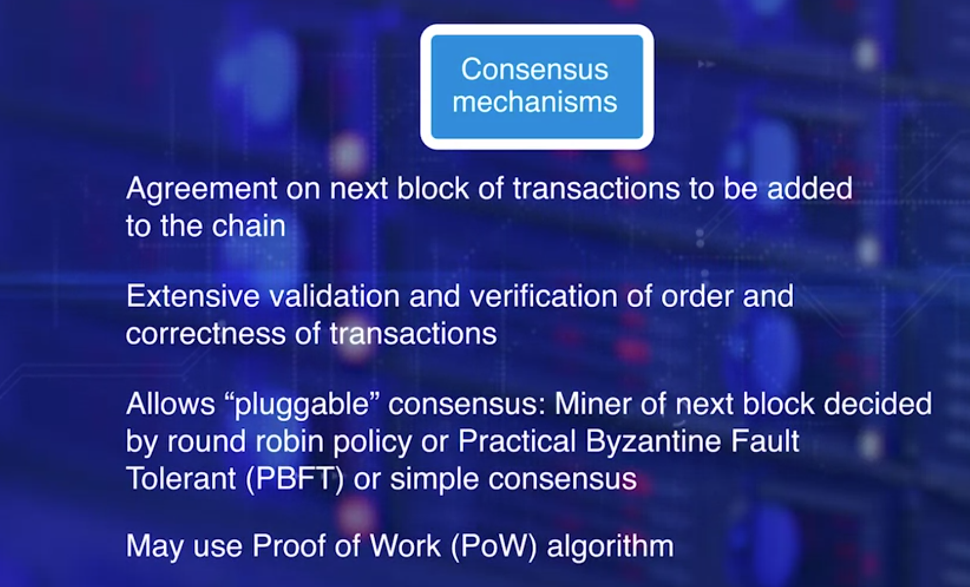
Course 4: Week1 Fabric Model & Functions
We are now moving into the final element of the Fabric model, the consensus model.
Consensus at the high level is the agreement on the next block of transaction to be added to the chain, and the extensive validation and verification of the order and the correctness of the transaction including double-spend and other conditions.
Fabric allows for 'pluggable' consensus model. That means, depending on the characteristic of the channel, the minor of the next block is decided by
a round robin policy or a Practical Byzantine Fault Tolerant or anything in-between.
If the channel is deemed to be highly trustworthy, a simple consensus model will do. If it is a business-to-consumer channel where there's a potential for malicious operations, even a Proof of Work algorithm can be plugged in as the consensus model.

Slide 22
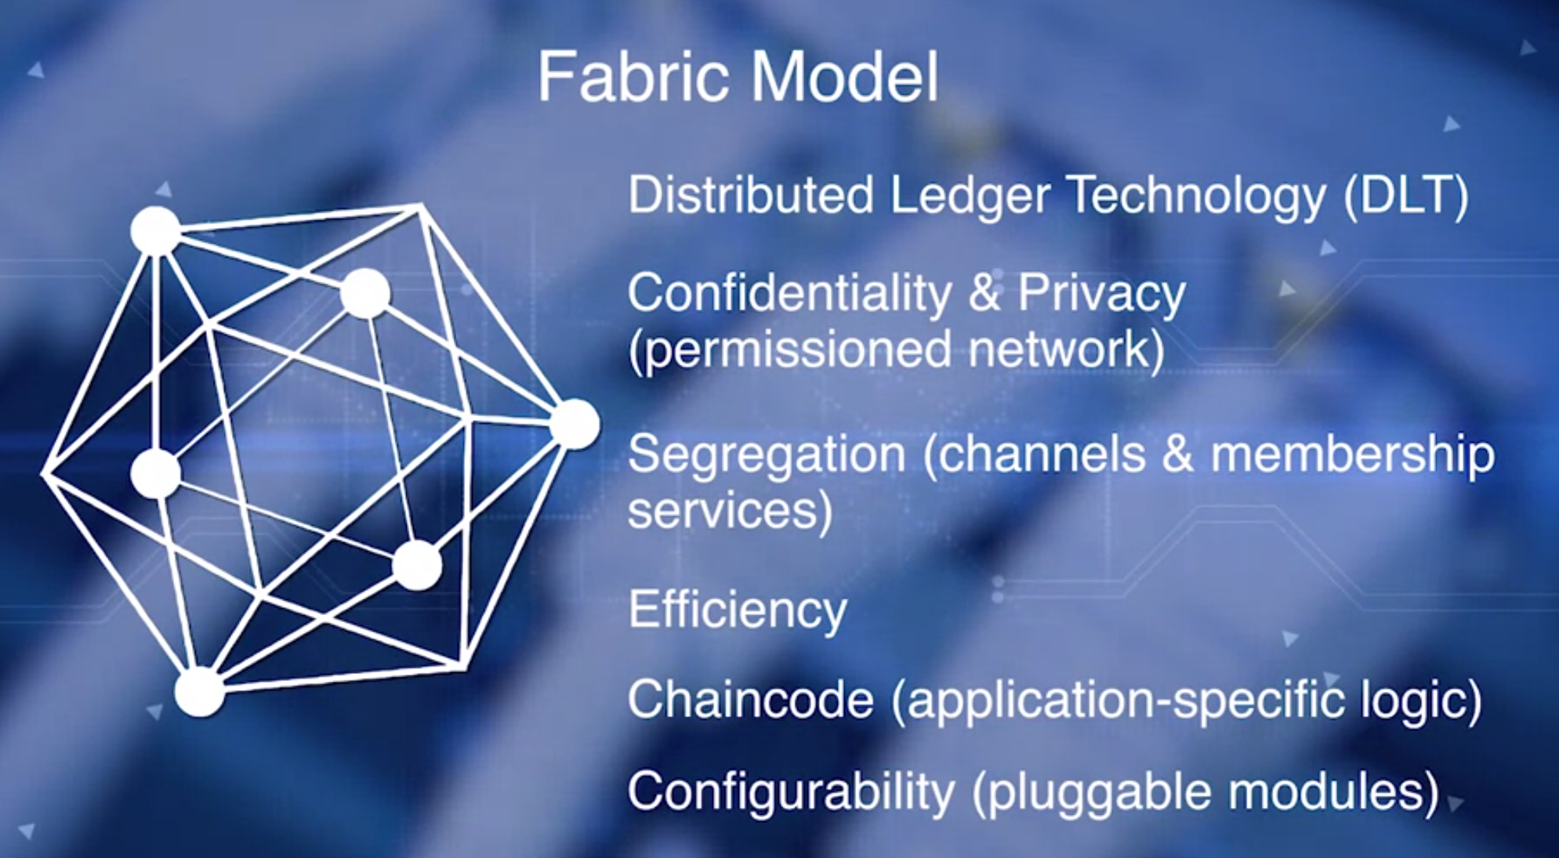
Course 4: Week1 Fabric Model & Functions
At the core, Fabric provides the Distributed Ledger Technology and through the various components we discussed in its model,
it provides these functionalities;
confidentiality and privacy through building a permission blockchain network among trusted business peers.
Fabric also offers segregation through the channels, identity management through membership services. It offers efficiency to various types of peer nodes operating in parallel, validating, ordering, and committing the transaction to the chain. Chaincode functionality helps in implementation of application-specific logic,
and configurability through modular architecture of the Fabric.
Allows for pluggable modules for anything from consensus model to the internationalization and policy modules for various regions of the world.

Slide 23
Course 4: Week1 Fabric Model & Functions
Hyperledger Fabric Model
https://hyperledger-fabric.readthedocs.io/en/release-1.1/fabric_model.html
This section outlines the key design features woven into Hyperledger Fabric that fulfill its promise of a comprehensive, yet customizable, enterprise blockchain solution:
Assets - Asset definitions enable the exchange of almost anything with monetary value over the network, from whole foods to antique cars to currency futures.
Chaincode - Chaincode execution is partitioned from transaction ordering, limiting the required levels of trust and verification across node types, and optimizing network scalability and performance.
Ledger Features - The immutable, shared ledger encodes the entire transaction history for each channel, and includes SQL-like query capability for efficient auditing and dispute resolution.
Privacy through Channels - Channels enable multi-lateral transactions with the high degrees of privacy and confidentiality required by competing businesses and regulated industries that exchange assets on a common network.
Security & Membership Services - Permissioned membership provides a trusted blockchain network, where participants know that all transactions can be detected and traced by authorized regulators and auditors.
Consensus - a unique approach to consensus enables the flexibility and scalability needed for the enterprise.

Slide 24
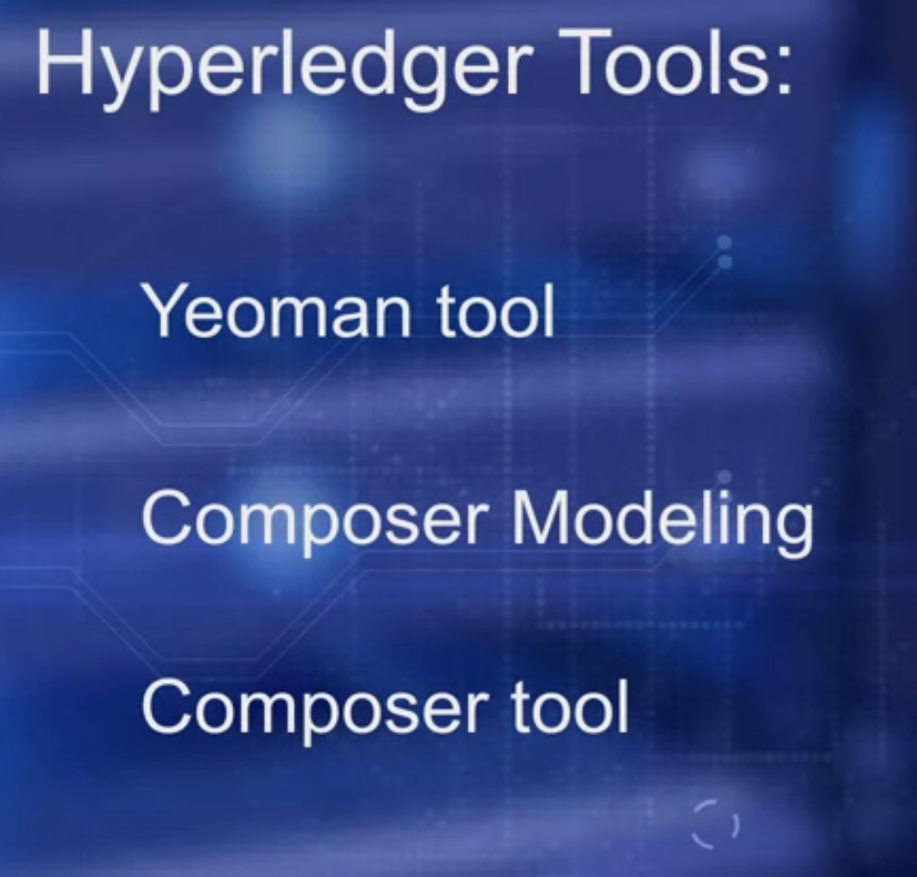
Course 4: Composer
The Linux foundation Hyperledger project not only
defines block chain frameworks by various partners such as IBM and Intel, but also specify several tools for developing applications.
The composer tool is similar to the truffled tool we used in course three for dApp development.

Slide 25
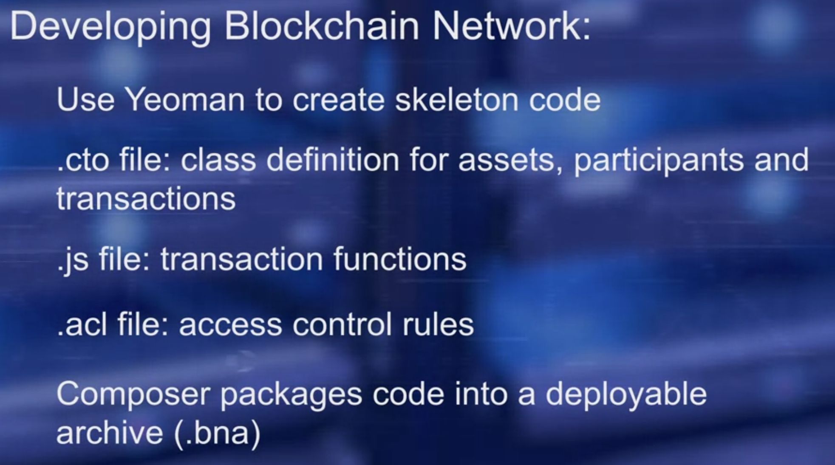
Course 4: Composer
We provide an overview of the techniques by using
the tools in the development of a simple business blockchain network.
Steps in development are; use human tool to create a skeleton code for the business network. In the CTO file created, you will find the class definition for all assets, participants, and the transactions in the business network.
This file is written in Hyperledger Composer modeling language. In the Javascript file are the transaction functions.
In the access control file (ACL), are the basic access control rules.
After updating the CTO JavaScript and ACL files, the entire directory is packaged using the composer tool, to package the code into a deployable business network archive.
Composer is used in setting the credentials, running in their server and deploying the application. The composer playground tool is executed to allow interacting with the deployed business network.

Slide 26
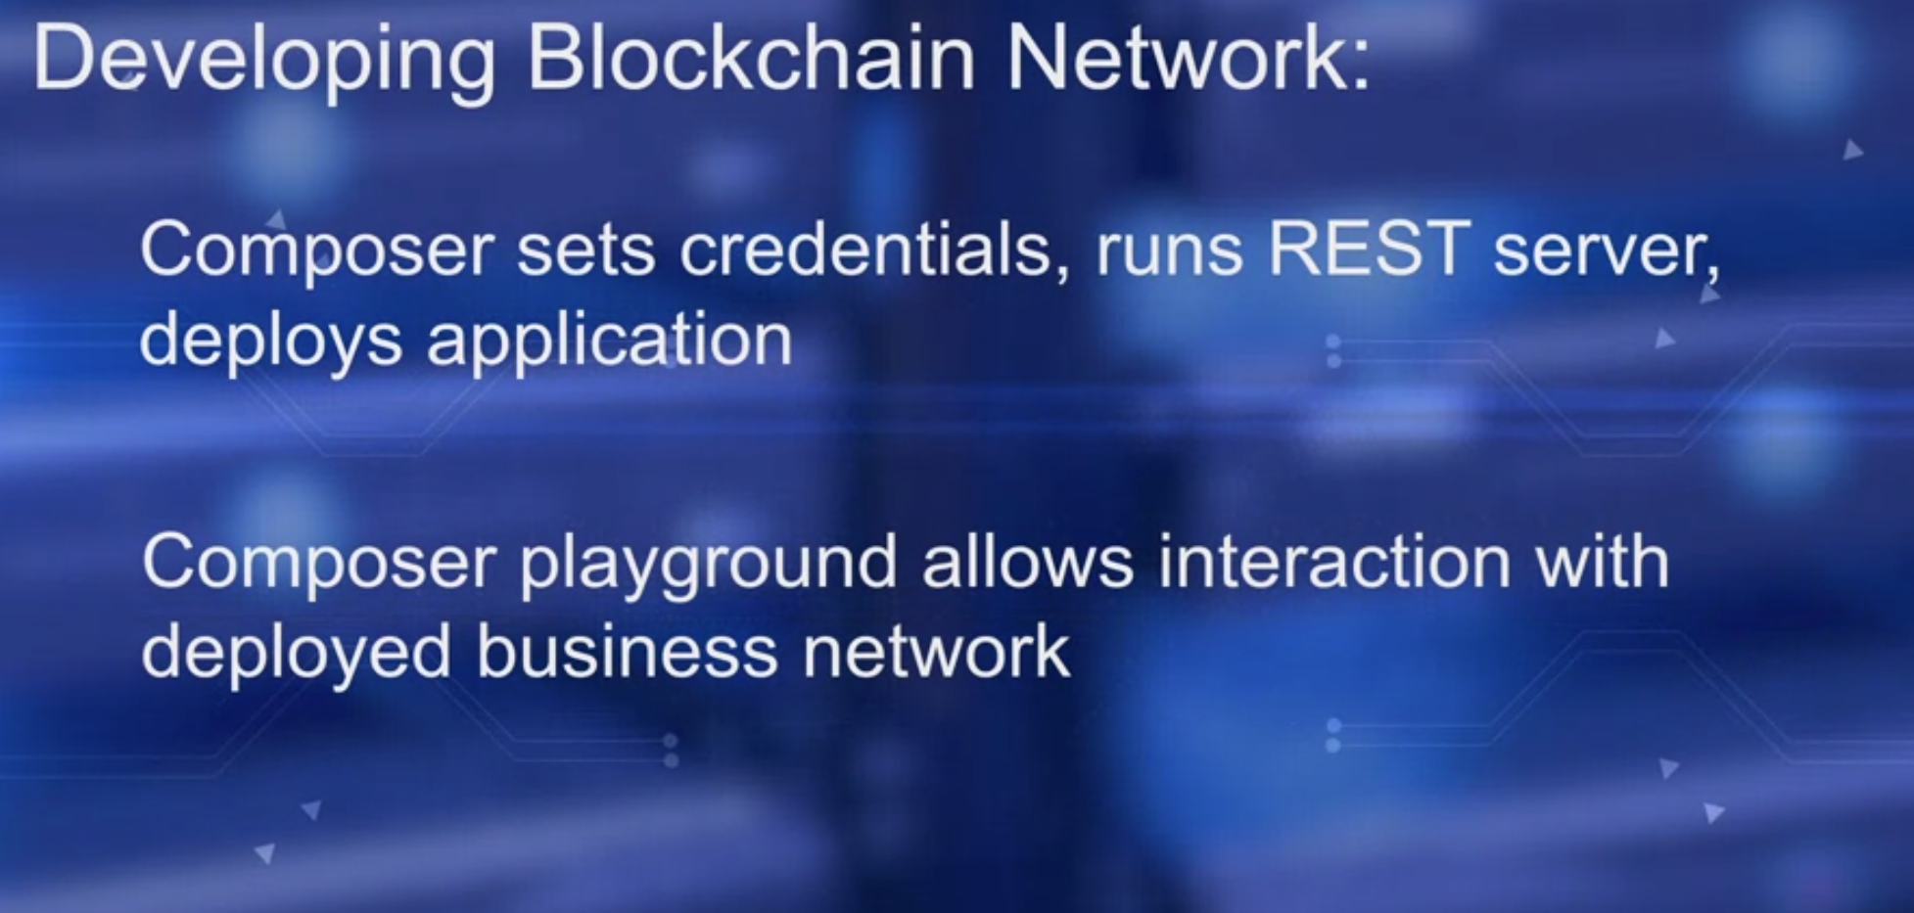
Course 4: Composer
Composer is used in setting the credentials, running in their server and deploying the application. The composer playground tool is executed to allow interacting with the deployed business network.

Slide 27
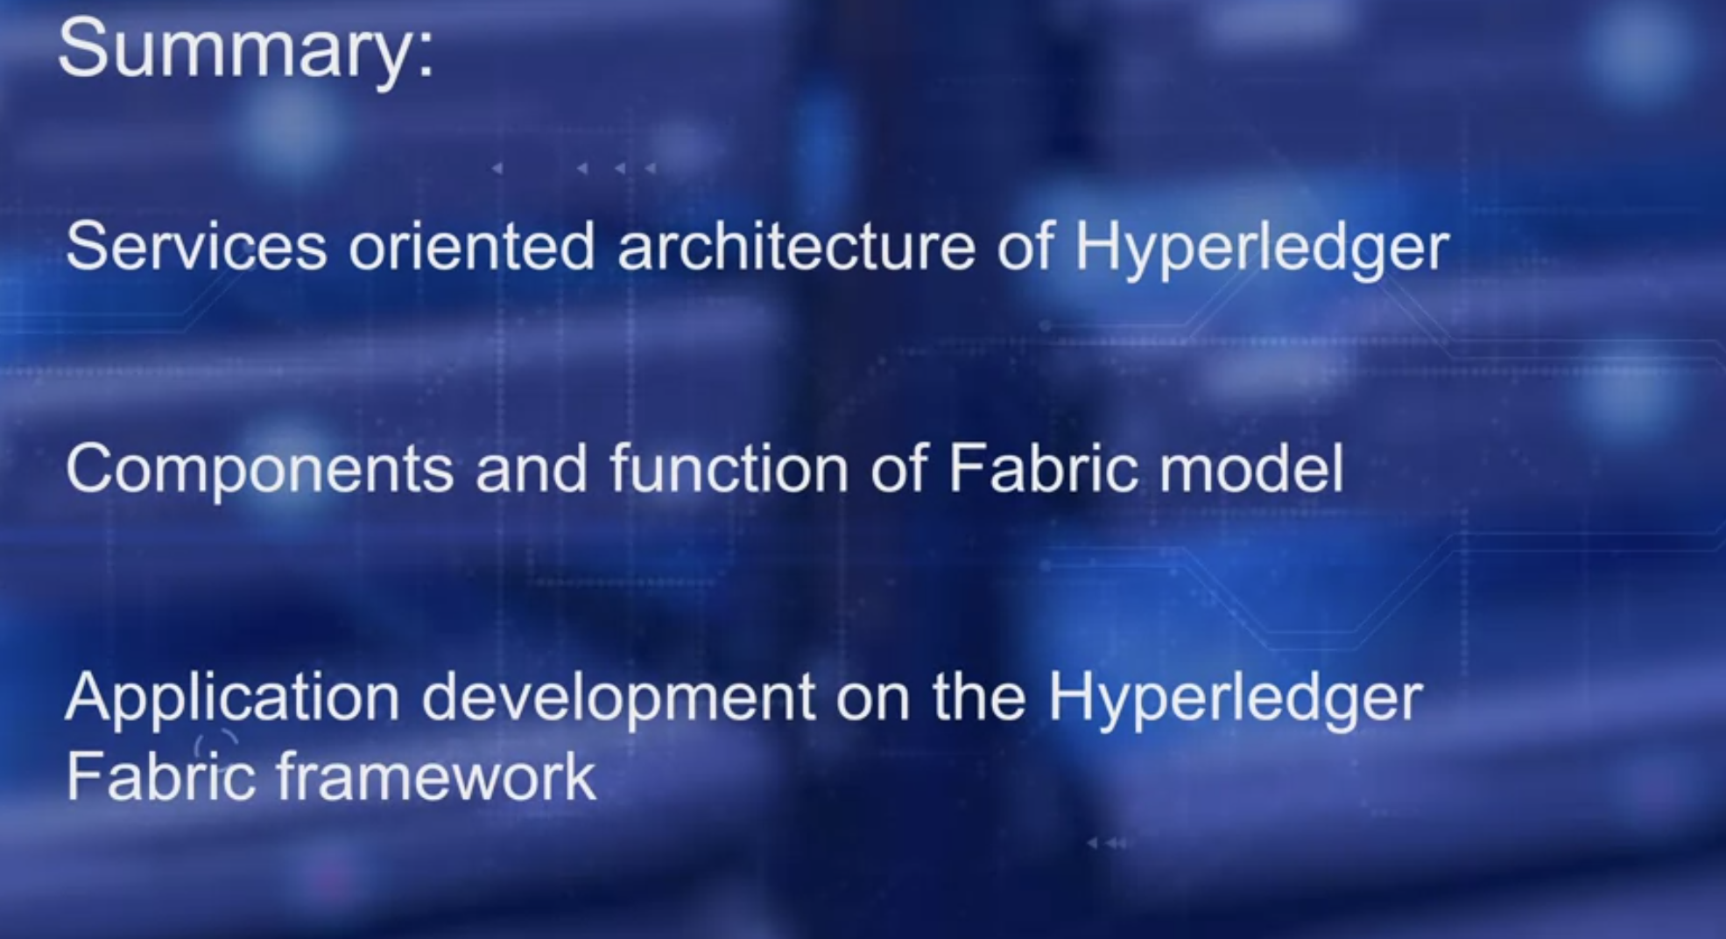
Course 4: Composer
In the last few lessons,
we discuss the services oriented architecture of Hyperledger,
components and functions of fabric model, and the application development on the hyperledger fabric framework, using Hyperledger composer tool.

Slide 28
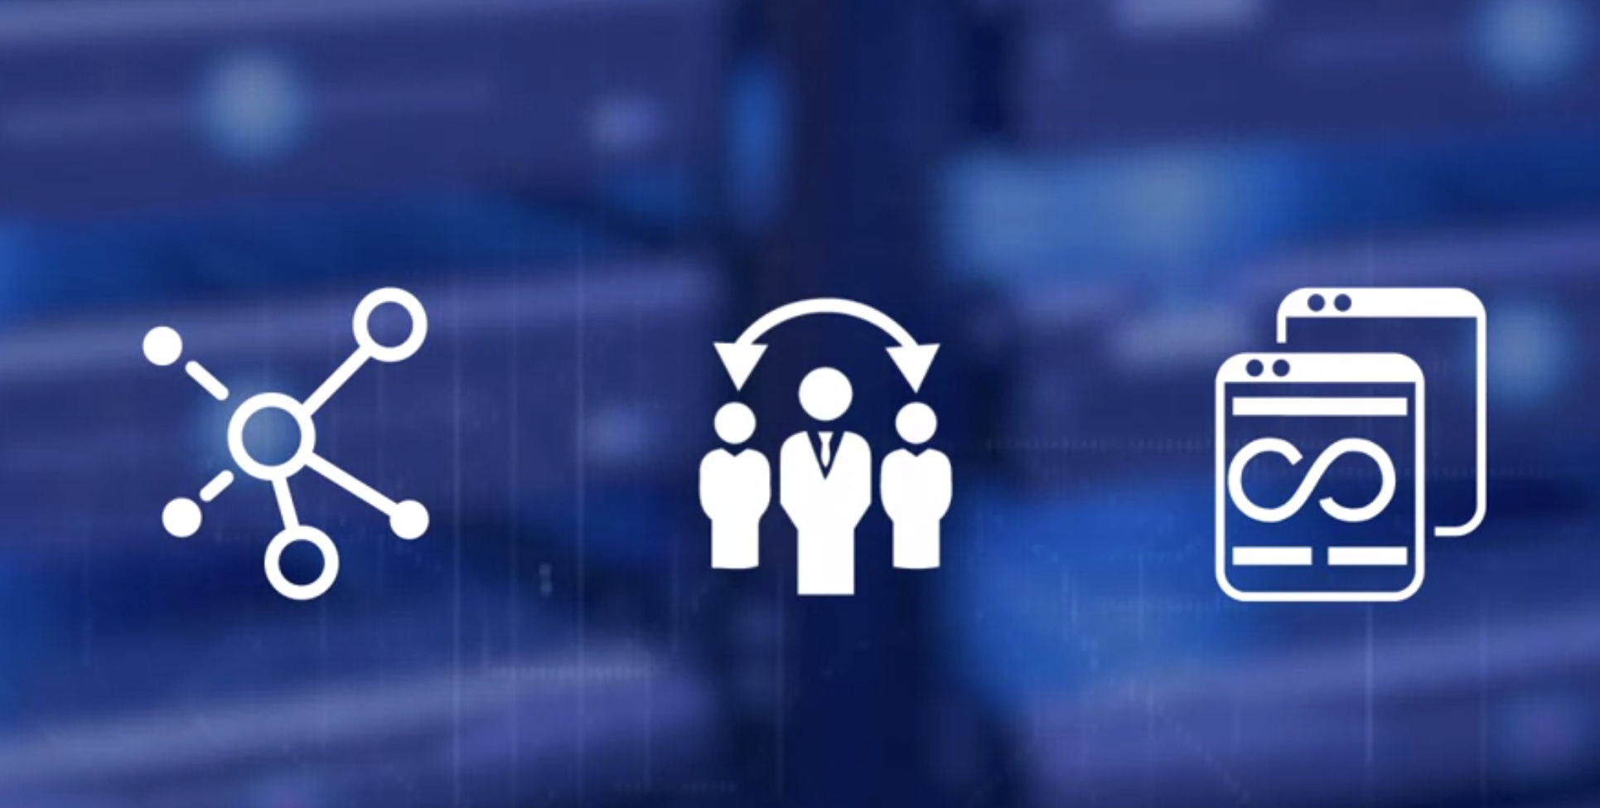
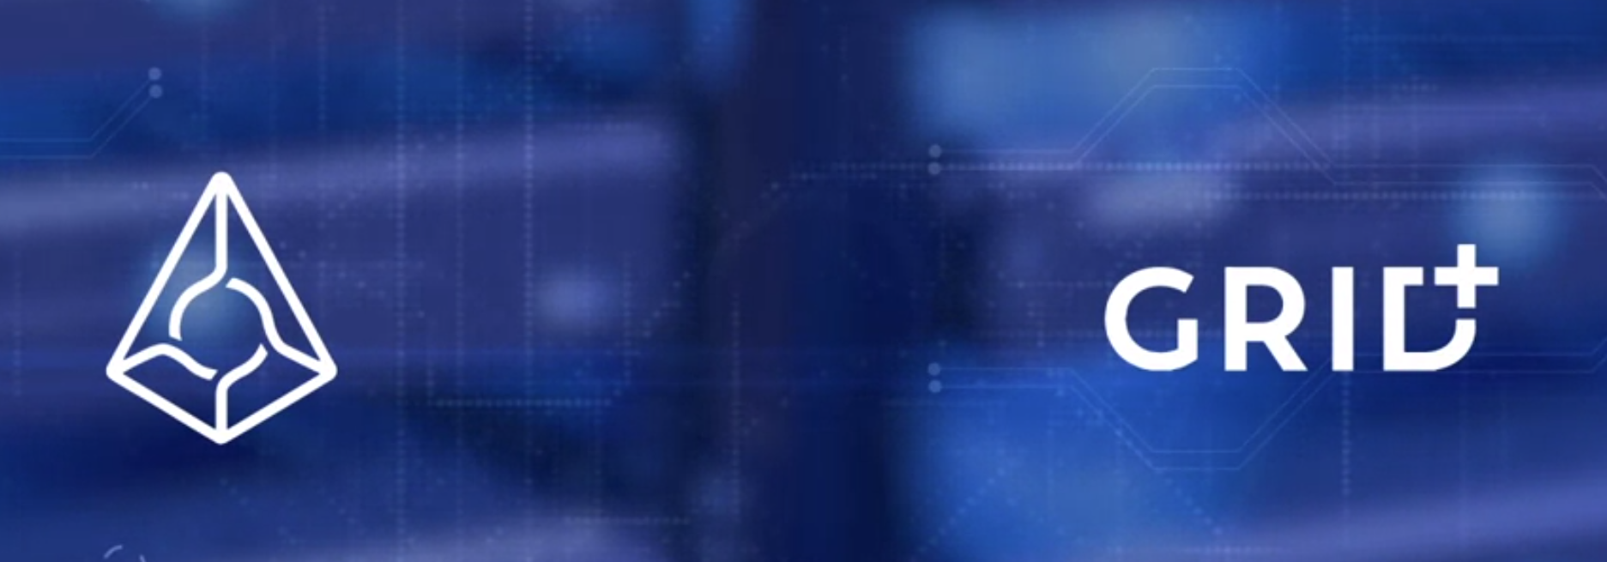
Course 4: Week2, Decentralized Application Platforms
ave you wondered about the practical application
that illustrates the special features of blockchain technology?
Namely, Decentralization, Disintermediation, and Distributed Immutable Ledger.
We'll explore two Dapp platforms;
Auger and Grid Plus, which are both implemented on Ethereum.
Auger and Grid Plus are layers above the smart contract,
each opening up the blockchain and the smart contract layer to the vast expands of vertical domains.
In this case, it is the prediction markets and the energy retailing, respectively. More importantly, you can be a participant in these Dapp platforms, if you wish to do so.

Slide 29
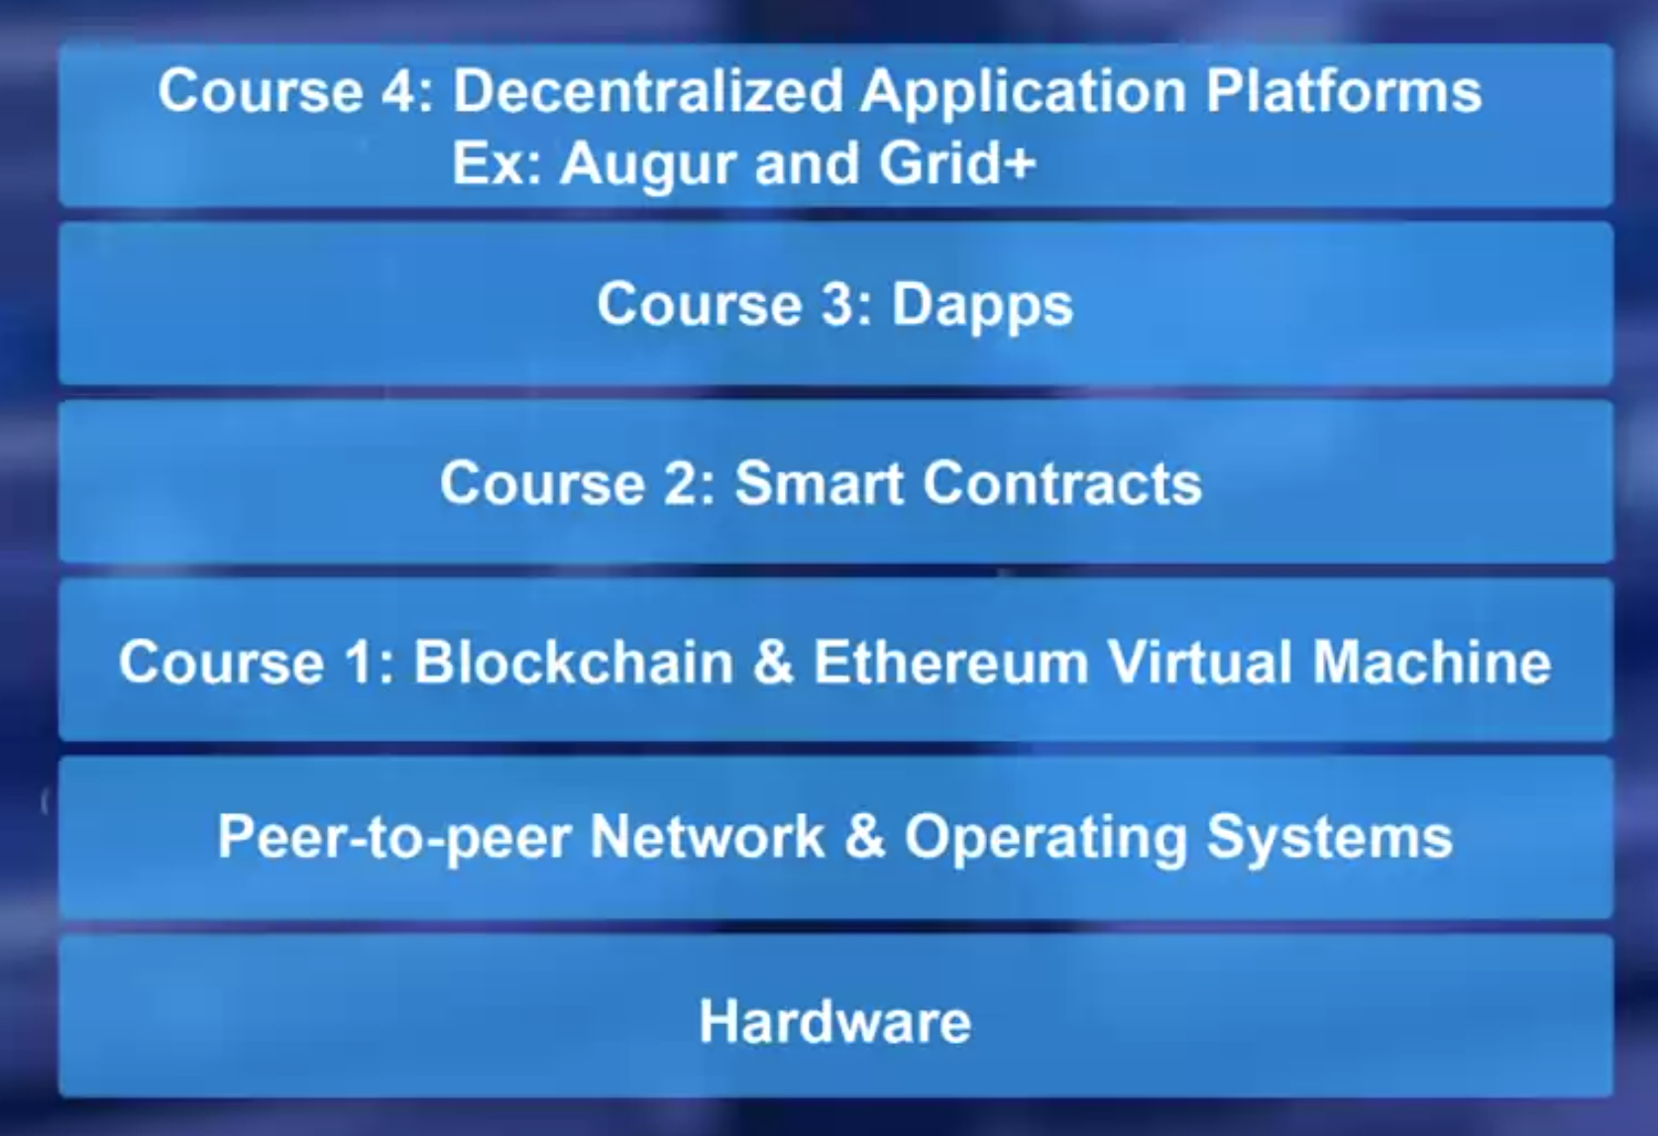
Course 4: Week2, Decentralized Application Platforms
where does the Dapp platform module fall in our specialization roadmap?
Recall material from earlier courses.
We've been developing these layers shown.
Previously we've developed simple Dapps, whereas here,
we'll explore a comprehensive platform for a vertical business domain and understand how smart contracts form a central role in these applications.

Slide 30
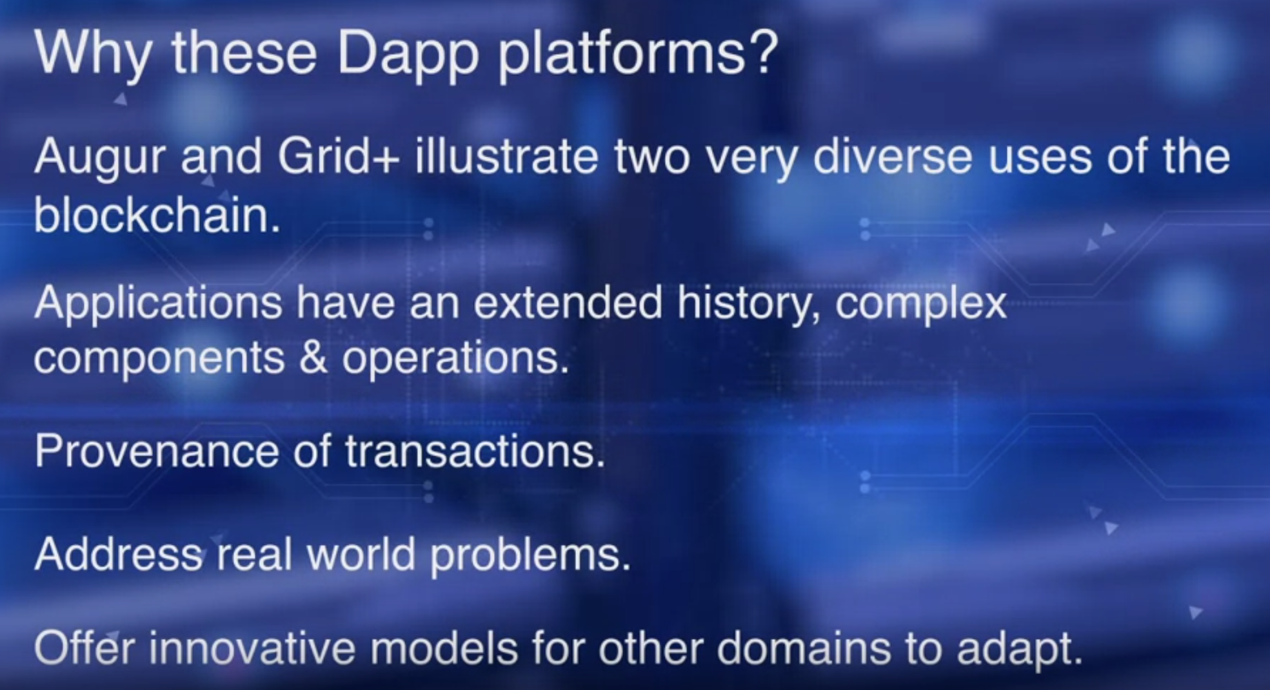
Course 4: Week2, Decentralized Application Platforms
Auger and Grid Plus are chosen
specifically to illustrate two very diverse uses of the blockchain.
These applications have extended history,
complex components, and operations.
Provenance of transactions are critical in both applications.
They are addressing real world problems, not hypothetical ones.
They offer innovative models for other domains to adapt.
On completion of this module, you will be able to discuss the architecture and working of Auger platform, list use cases for Auger,
explain the architecture and working of Grid Plus platform, and explore how Grid Plus can be used.

Slide 31
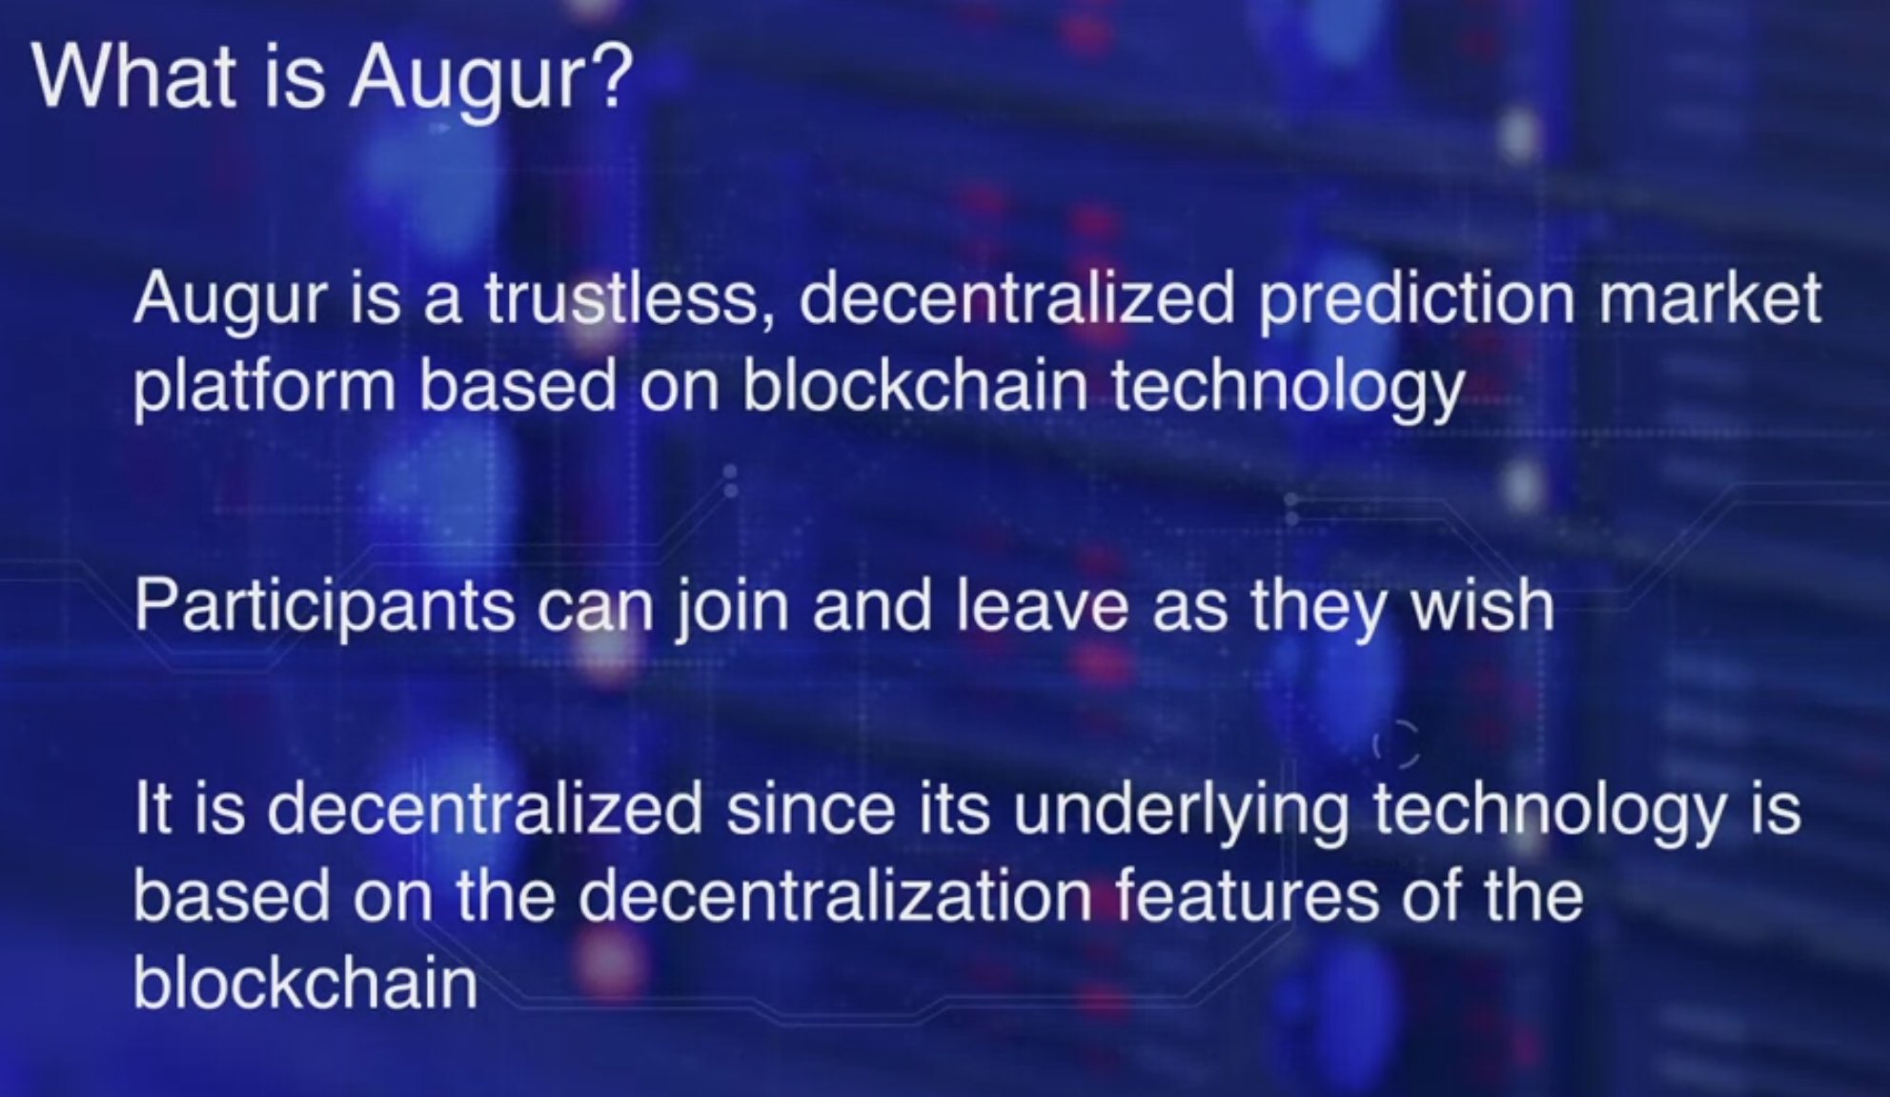
Course 4: Week2, Augur
Augur leverages the trust decentralization of the blockchain and opens up the prediction markets to the wisdom of the crowds.
Participants can join and leave as they wish. That's why it is trustless. It is decentralized since its underlying technology is based on the decentralization feature of the blockchain.
The participants are not bound by any central authority. In a typical mode of operation, a market creator post a market event for which she seeks the wisdom of the participants.
Market reporters speculate on the outcome of this event. Once the outcome is known, the participants who forecast the outcome correctly, win a payback and others lose the money they put in it.
The end-to-end process is carried out automatically by the Ethereum Smart Contracts.

Slide 32
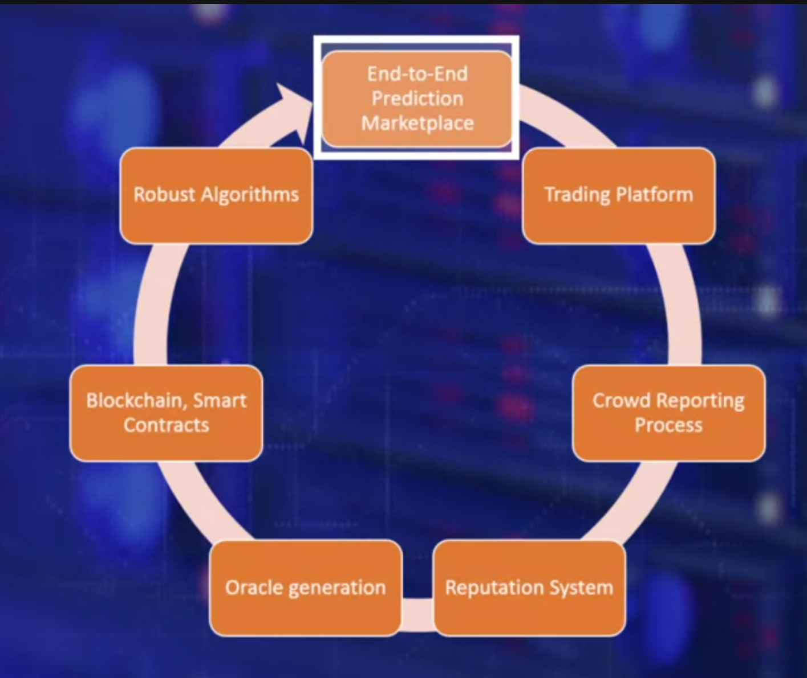
Course 4: Week2, Augur
End-to-end Prediction Market, Augur facilitates an end-to-end process from creation to settlement of a prediction on anything, from an idea of project, proposal, stock, stock futures, pouts and experiment in others.
This is set up by a smart contract. The next key idea is the trading platform. To give just a few examples, Augur allows decentralized global trading on any idea, a proposal and event outcome or the effect of a policy.
Trading patterns can be used to forecast outcomes. Since all of these are decentralized, anybody anywhere can participate. The next idea is reputation system.
Augur provides a platform for decentralized participants to speculate on an event outcome based on their belief, then the crowd reporting process.
Augur features an incentivized model for materializing the wisdom of
the crowd using its own token rep or reputation token. Oracle, Augur captures the wisdom of the crowd in a secure Oracle that could be accessed by the underlying smart contracts for resolving the outcomes.
Prediction markets is indeed a complex system that's why we need an automated auditable smart contract based system to implement Augur in a decentralized context.

Slide 33
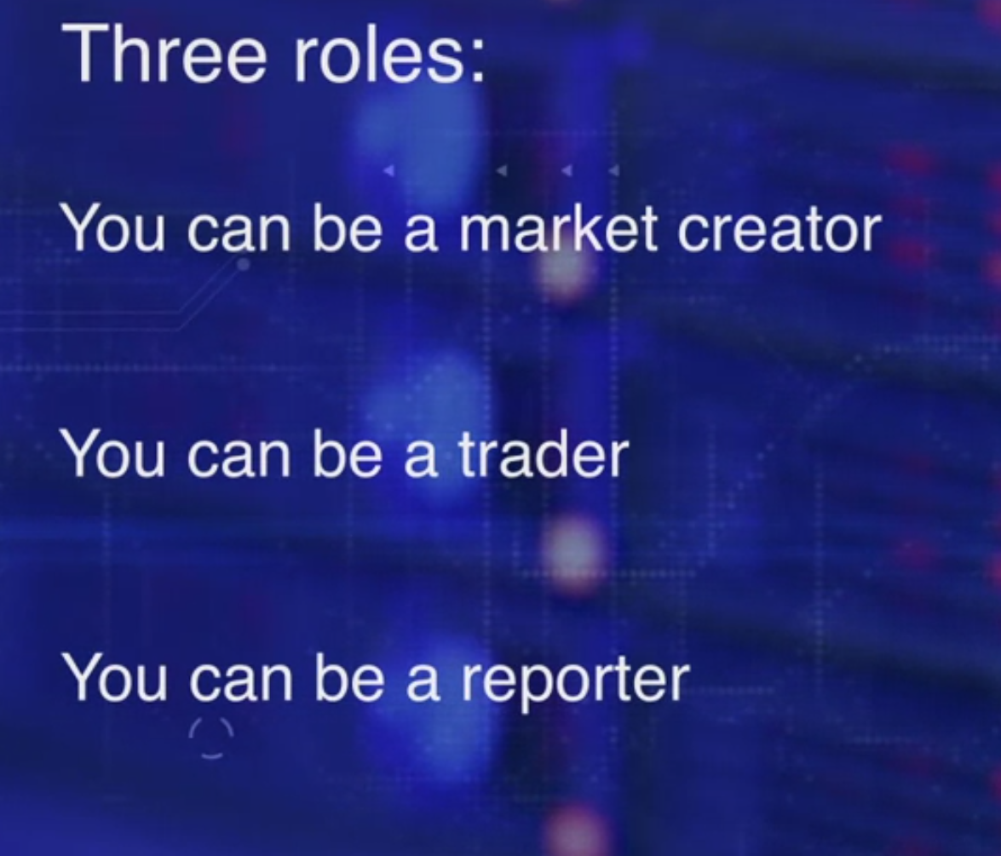
Course 4: Week2, Augur
There are three main roles or types of participants.
You can be a market creator, who places the market event and sets the expected outcomes, pays fees and escrows, and establishes the rules, and designates the initial set of reporters.
You can also be a trader, who places the bets on the expected
outcomes and takes part in the pre-reporting phase of the process. Traders buy and trade shares that bet on the odds of the outcomes.
The trading currency is currently Ether, that of Ethereum blockchain.
In the next role, you can be a reporter, who reports on the outcomes.
Understand that outcomes do not have to be binary, as we all know.
The reporter can be a designated reporter, or an open reporter, based on the phase of the process.
The prediction process runs it's course.
Do not expect just one round of crowd reports to arrive at a prediction outcome. Most of them may take years by nature of the idea.
Outcomes may not be binary. It can be scalar with many possible outcomes.

Slide 34
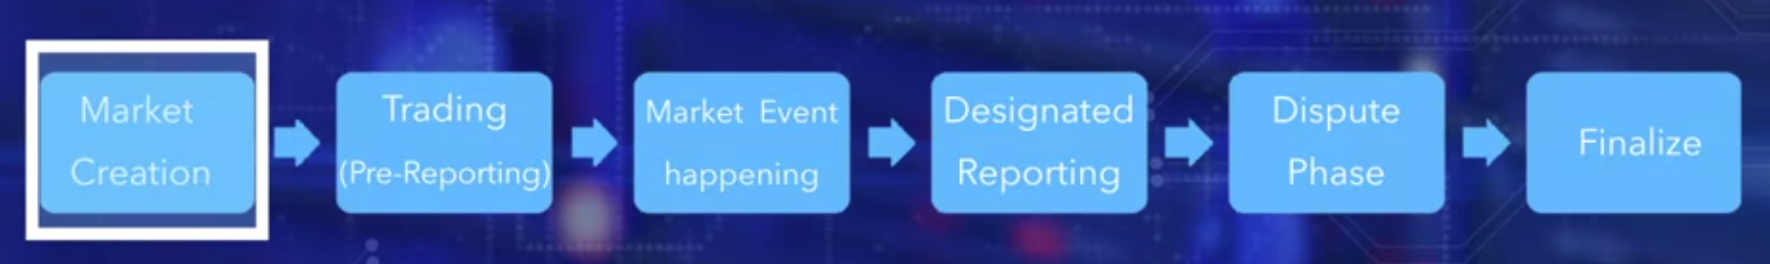
Course 4: Week2, Augur
high level understanding of the process. A stakeholder creates a marketplace. This results in configuration and deployment of smart contracts on the Ethereum network. Rep tokens are used in this process and Ether for smart contract executions. Trading begins as soon as a prediction event is posted. The designated reporting period begins. After the designated reporting period, a ten-to-two outcome prediction may be available.
If not, the first prediction after this is assumed to be the predicted outcome.
It can be disputed by the reporters by staking rep tokens. In the worst case, the dispute phase made it result in a fork. Augur protocol has robust methods to address forks and the disputes. Next, the prediction phase ends with a prediction.
The event happens. The next phase of reporting begins. At the end of the reporting period, the collective reported outcome is a availble as an oracle.

Slide 35
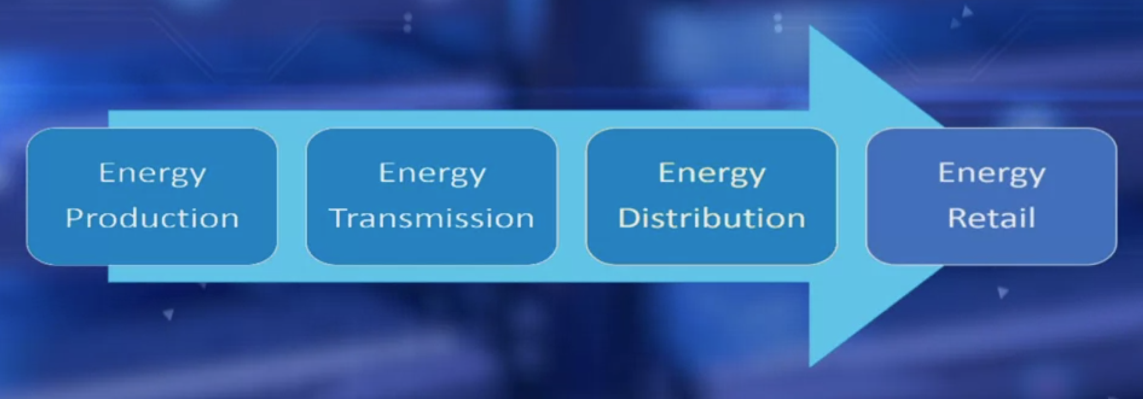
Course 4: Week2, Grid+
Shown here are four phases of the energy supply chain: production,
transmission, distribution, and retail.
Of these, Grid+ focuses on innovating the energy retail sector with the integration of the blockchain technology.
There are opportunities for modernization, improving efficiency, updating payment system, and cost cutting for the end-user. Field experts suggest that about 50 percent of the end-user energy cost is not for electricity but for the administrative warheads.

Slide 36
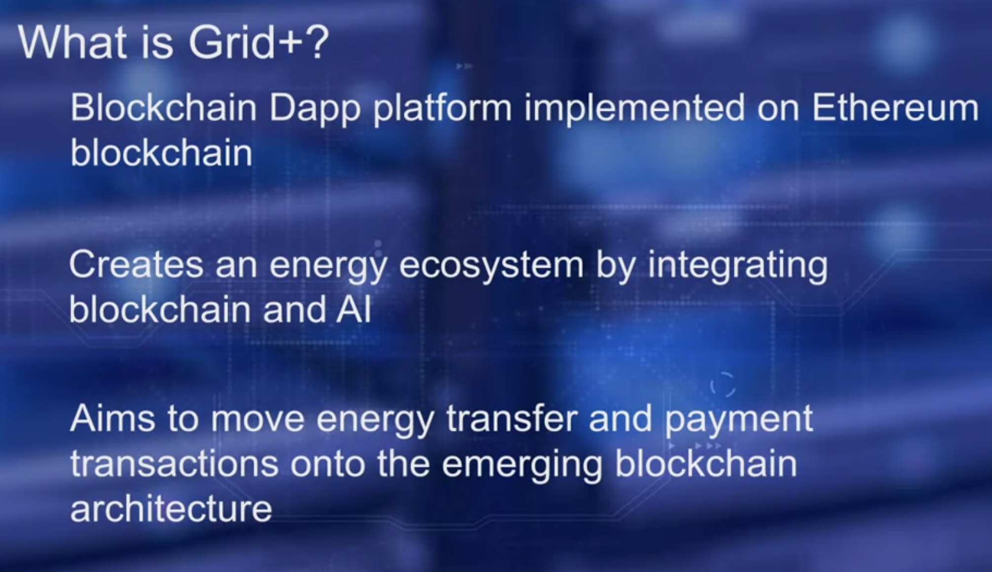
Course 4: Week2, Grid+
Grid+ pushes market signals to the end-users who can retain
control of their energy assets and make smart decisions.
This improves energy usage efficiency and also reduces costs to the end-user.
Grid+ provides a seamless payment system,
leveraging crypto tokens, thus improving efficiency in the energy payments system. Have you noticed, it's all about disintermediation of the energy system.
In a deregulated electricity market, market participants other than the utility companies own power plants and transmission lines. In such contexts, the companies that generate electricity, sell electricity into a wholesale market,
and the retail energy suppliers purchase this electricity to sell it to the customers.
This deregulated electricity market offers an opportunity for Grid+ to test its operational capacity and commercial viability.

Slide 37
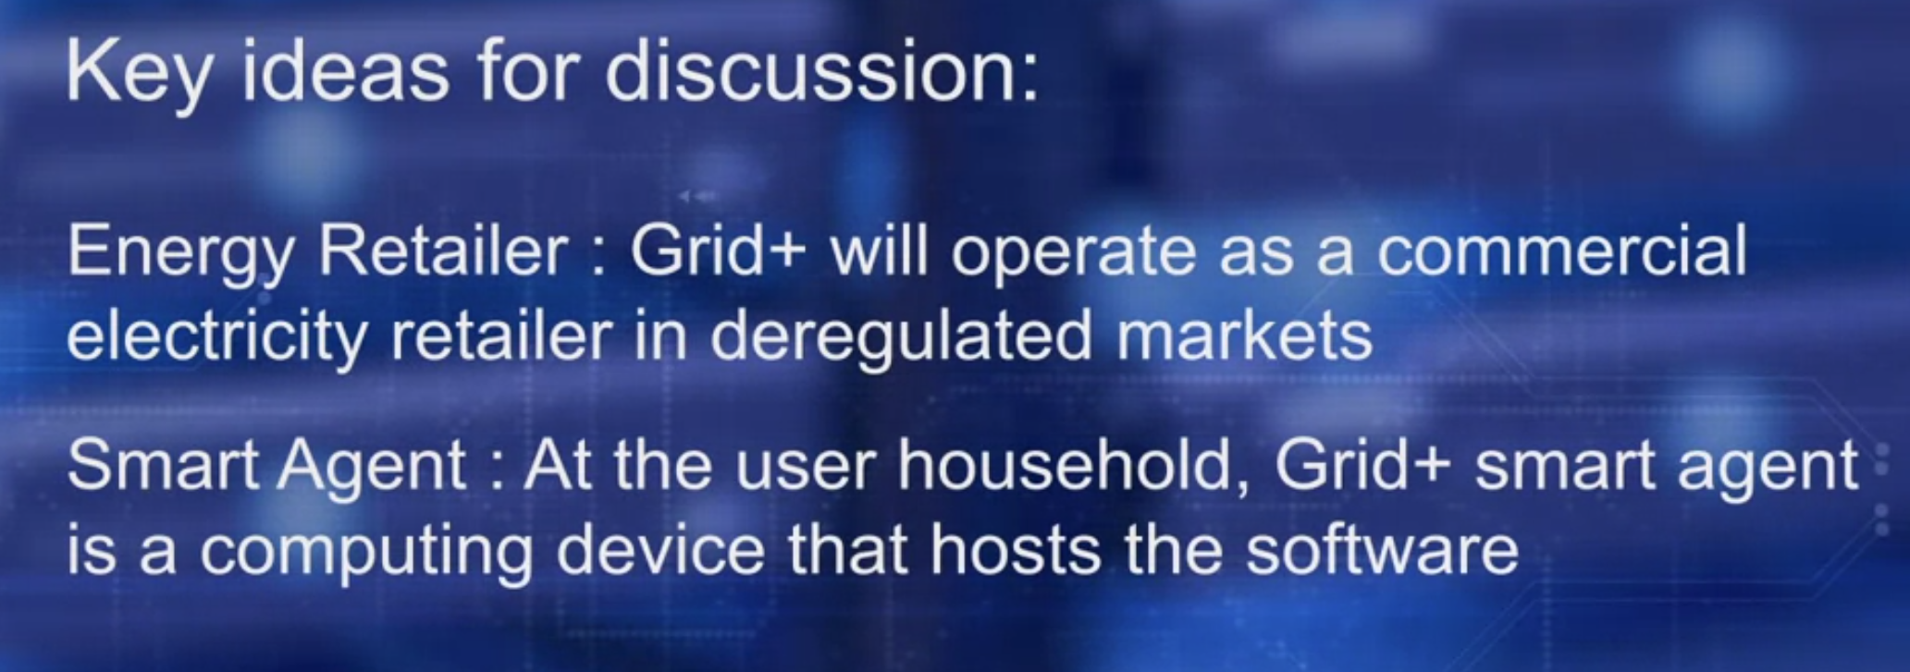
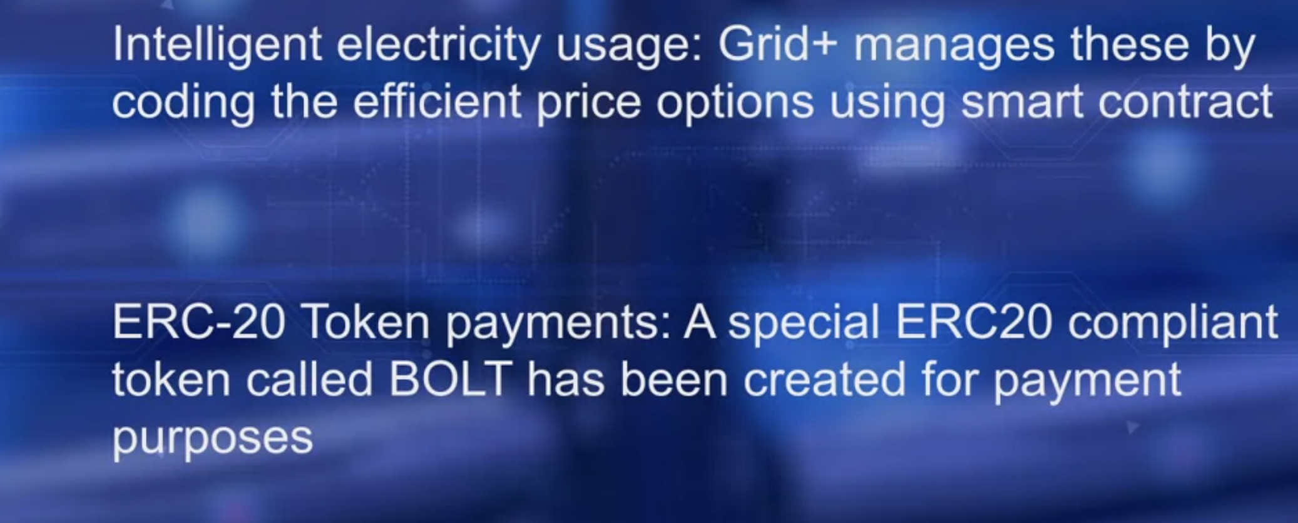
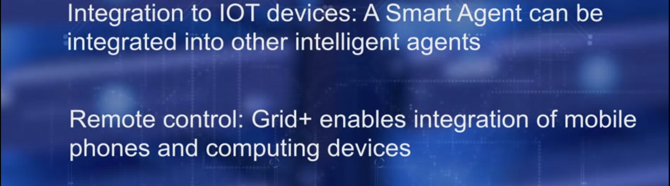
Course 4: Week2, Grid+
A Grid+ Smart Agent is a computing device that hosts a software for blockchain transaction, multi-signature crypto wallet with PKI security, and off chain payments for faster confirmations.
Next key idea is the intelligent electricity usage.
Electricity trading is a complicated process with many intricacies, Grid+ manages these by coding efficient price options for the customers using smart contract.
ERC20 Token payments: A special ERC20 compliant token called BOLT has been created for payment purposes.
Integration to Internet of Things devices, IoT devices: A smart agent can be integrated into other intelligent agents in a household like NEST and electric batteries such as Tesla Power Wall. Remote control: Grid+ enables integration of mobile phones and computing devices to allow remote control of its operation. Intuitive user interface that allows easy interaction with the system.
Even though blockchain and crypto token are involved,
the end-user does not require any technical knowledge about the underlying infrastructure

Slide 38
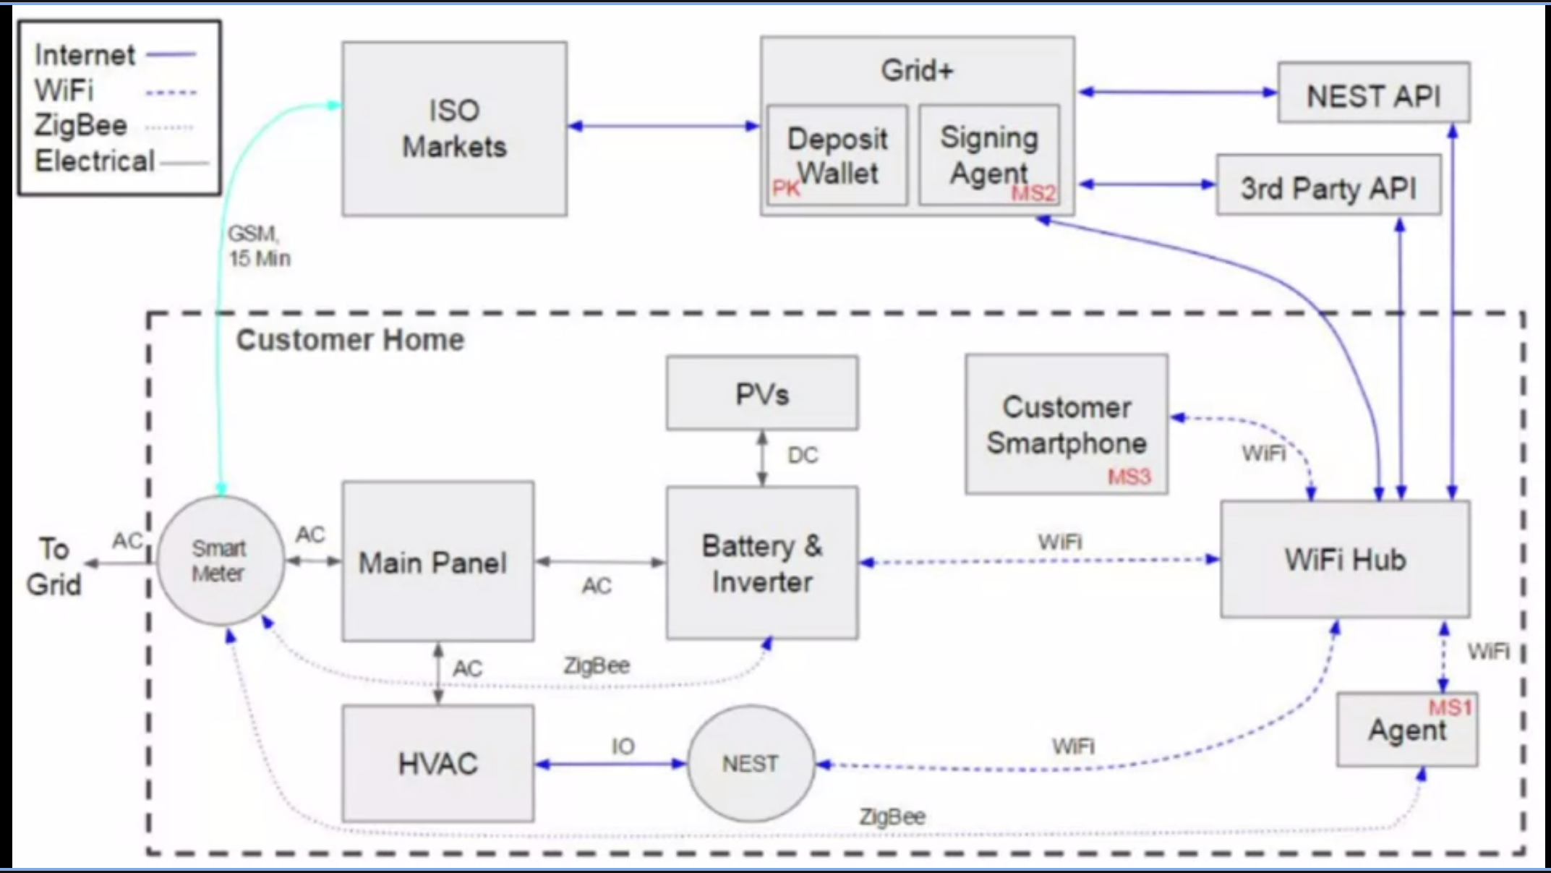
Course 4: Week2, Grid+
The components inside the dotted rectangle are at the consumer's location, maybe a residential house.
It has a smart meter, main panel,
several electricity-based devices, heating ventilation, air conditioning, HVAC, battery, PVs or photovoltaic devices that could be, solar panels generating electricity.
n the right side are the wireless hub devices such as NEST, customer smartphone, and finally at the bottom, you see the Grid+ smart agent, SA.
Smart agent is connected via the Internet to the Grid+ retailer shown at the top. Grid+ under smart agent are deployed on the blockchain.

Slide 39
Course 4: Week2, Grid+
You can also see three signatures, MS1, MS2 and MS3. Grid+ is indeed multi-sig with two out of three sign for triggering a transaction. Users can use smartphones. MS3 and MS2 are used to control and configure smart agent. Even if the smart agent is stolen or compromised, it cannot be misused and coins in it cannot be misused because it is multi-sig. Grid+ working. Compare the Grid+ architecture with dApps we developed. The former is indeed a complex interplay of many systems. The smart contracts and the blockchain are the new system components in the electric grid, automating the de-centralized usage and the energy generators.

Slide 40
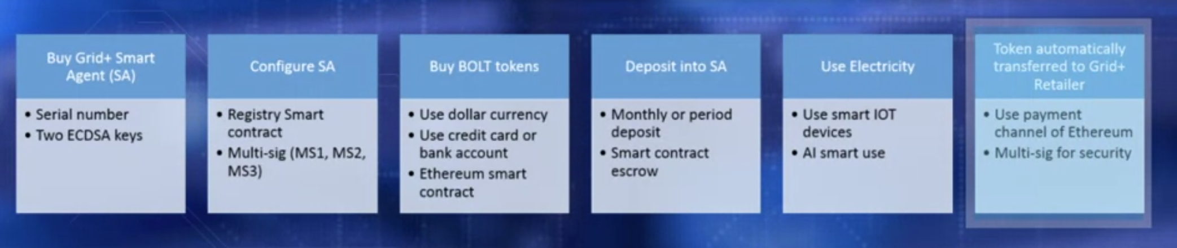
Course 4: Week2, Grid+
The user buys the smart agent. Using the serial number on the device that is unique, two keys are generated.
Based on these and a registry smart contract, the smart agent is configured. User then buys BOLT coins as tokens provided by the Grid+ using regular money, credit card, or bank card. A smart contract keeps track of the BOLTs as escrow in the smart agent. Users now can use electricity and can use smart devices such as NEST to optimize usage.
Based on the usage, BOLT is automatically transferred to the Grid+ retailer using a off-chain payment channel.
User also has a BOLT deposit at the retailer for any overuse than earlier configured in the smart agent.
Grid+ estimates the energy required for a period for all its customers based on their smart agent configuration.
It buys the amount in wholesale and sells it at retail. All this automated using AI, artificial intelligence, and smart contracts.
In summary, Grid+ leverages smart contracts and blockchain technology to eliminate intermediaries in the energy market. This is accomplished by automation of the payment process
and optimizing the usage patterns to supply patterns.

Slide 41
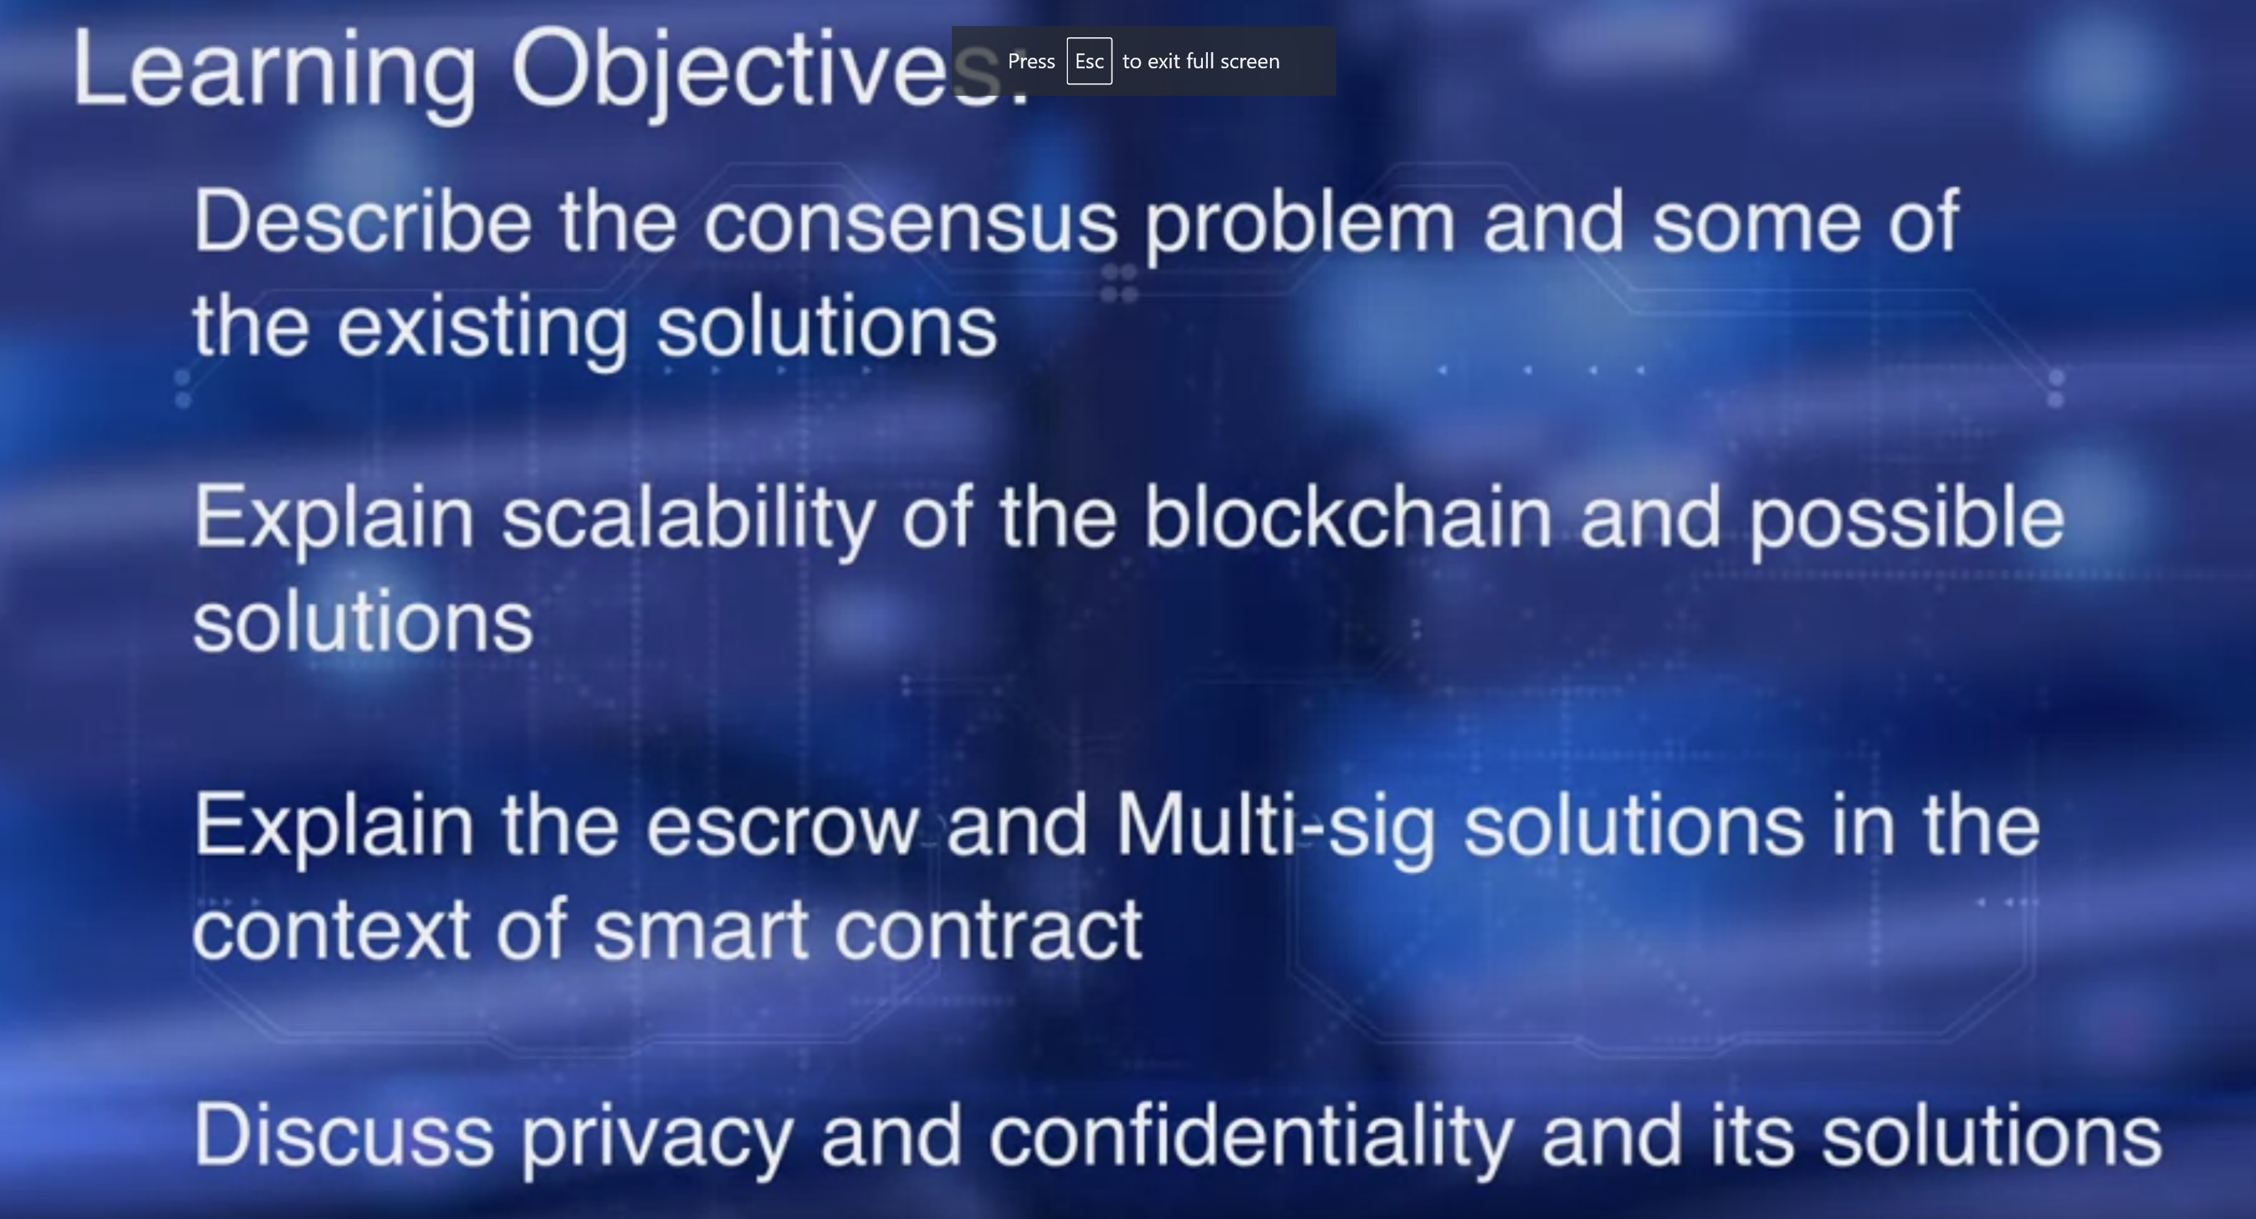
Course 4: Week3, Challenges & Solutions

Slide 42
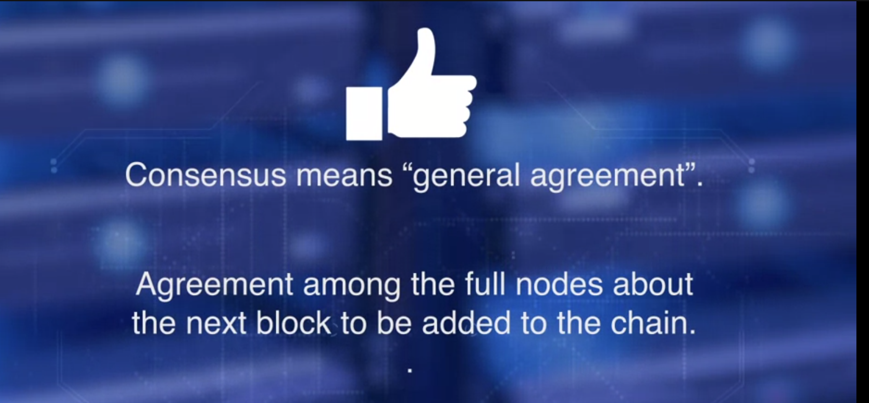
Course 4: Week3, Challenges & Solutions (Consensus)
Consensus means general agreement. In the context of blockchain operation, consensus is an agreement among the full nodes about the next block to be added to the chain. This ensures the integrity of the chain.
Even among the known permissioned entities, we need consensus.
Different consensus protocols are used in various blockchains.
Bitcoin uses proof of work for consensus.
It is computationally intensive, and results in enormous power consumption in the massive racks of ASIC computers used in solving the POW puzzle, for the right to mine the next block.

Slide 43
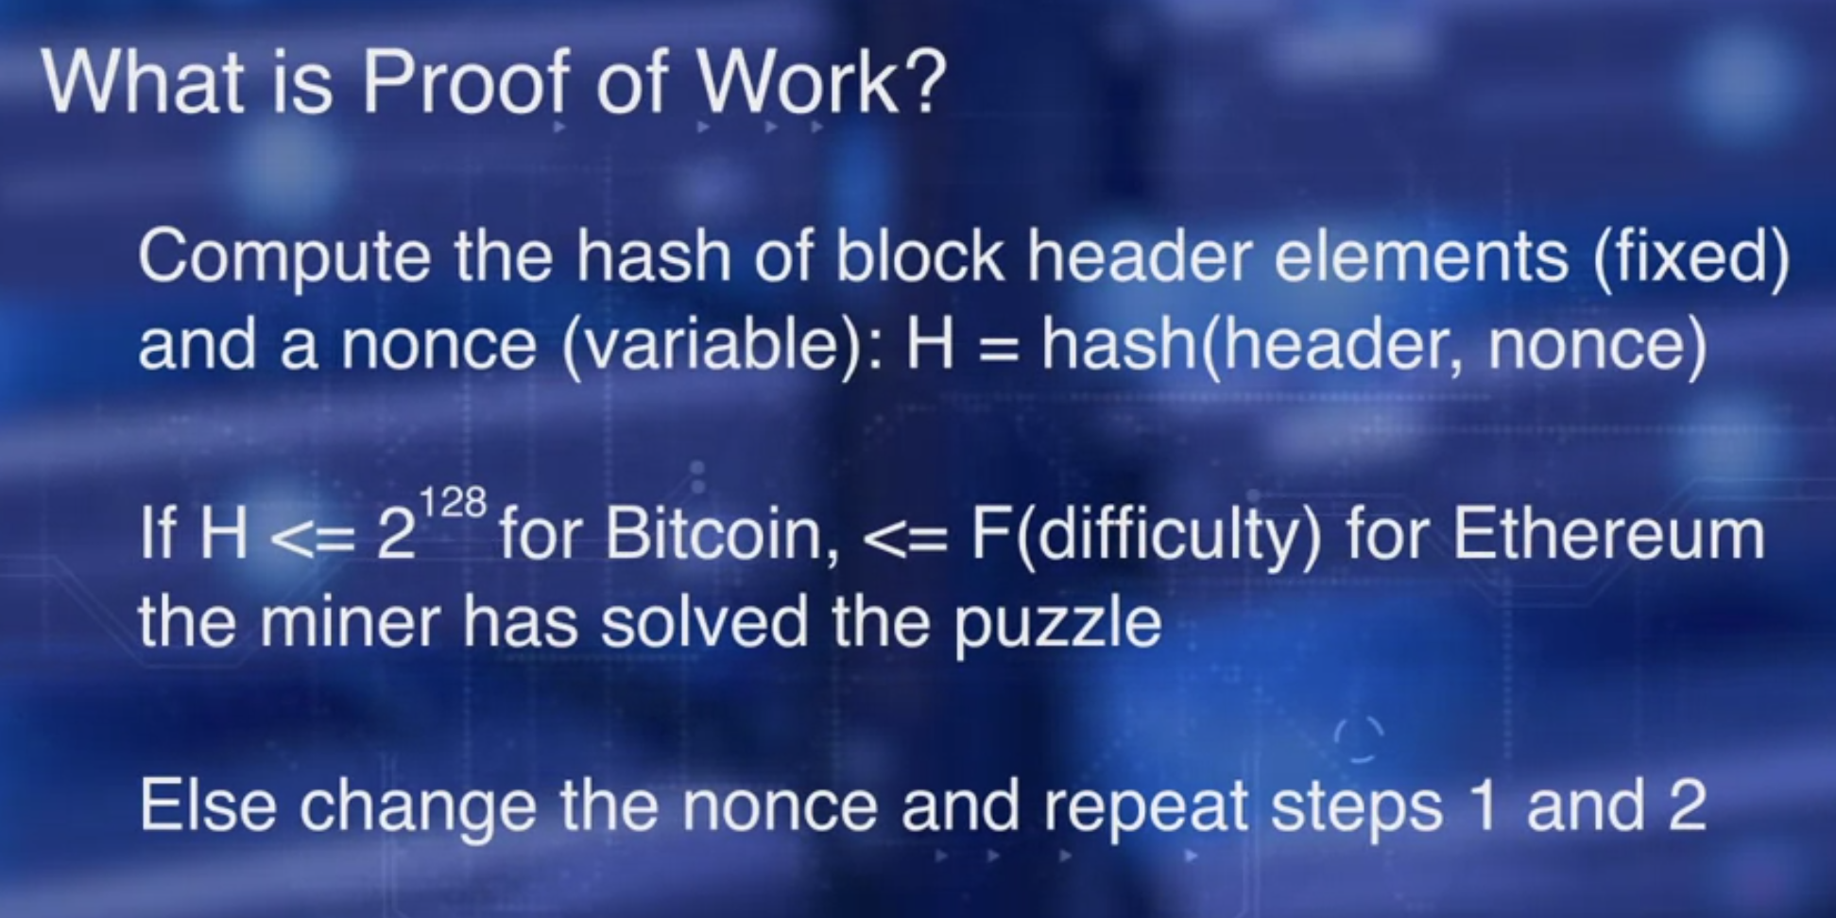
Course 4: Week3, Challenges & Solutions (POW)
Compute the hash of the block header elements that is fixed and a nonce that is a variable.
H is the hash of the header and nonce. If the hash computed is less than 2 to the power of 128 for Bitcoin and less than function of difficulty for Ethereum, the miner has solved the puzzle.
Otherwise, change the nonce and repeat the steps above.
While it is difficult to find the combination of header and
nonce that solves the problem we described about, it is easy to verify.
How do you verify that hash is less than or equal to 2 to the power of 128?
Check if the leading 128 bits of the hash H are 0.

Slide 44
Course 4: Week3, Challenges & Solutions (POW)
Bitcoin used Proof of Work, or POW, and Ethereum followed it with slight modifications.
In the current version, Ethereum Metropolis, it still utilizes Proof of Work.
However, Ethereum Metropolis protocol uses a memory based proof of work that is not energy intensive.

Slide 45
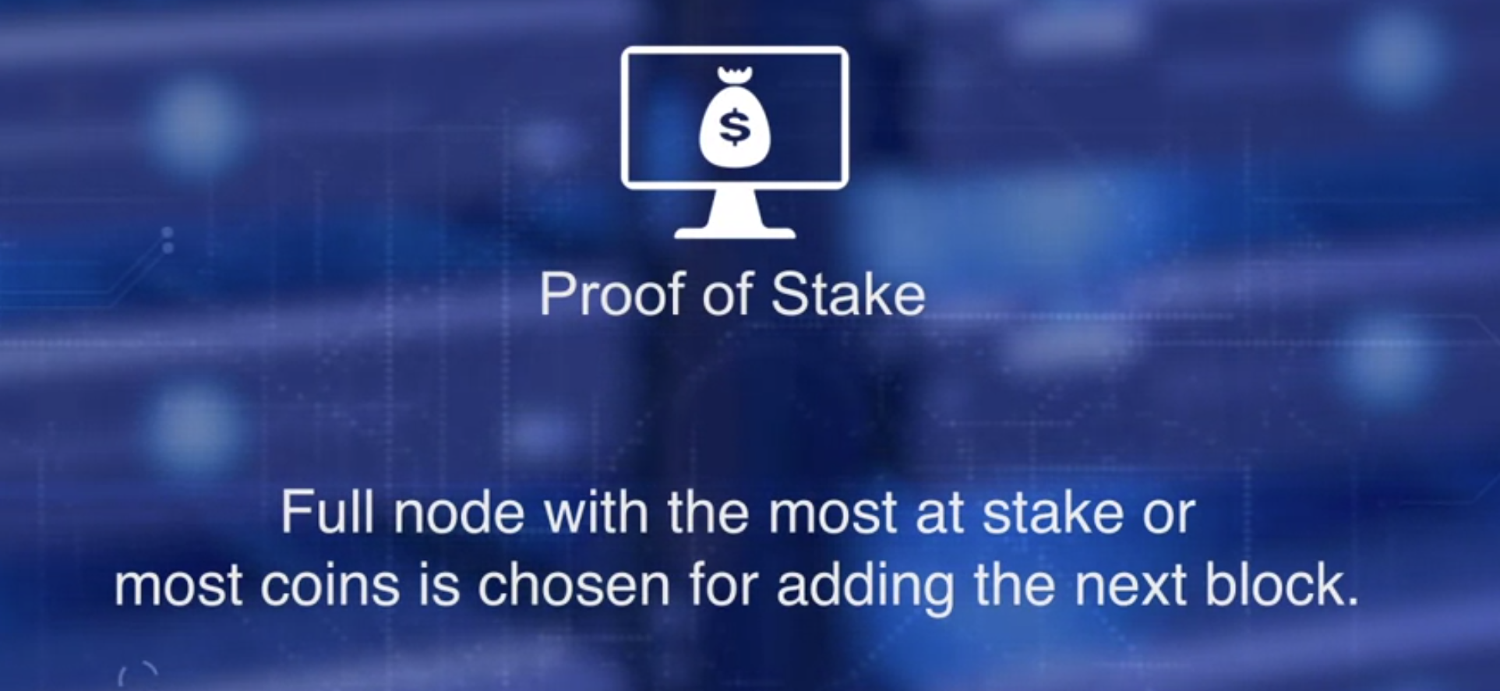
Course 4: Week3, Challenges & Solutions (POS)
What is POS?
In Proof of Stake, the full node with the most at stake or most coin is chosen for adding the next block.
That is why it is called Proof of Stake. The idea is, that node with the most stake will not be malicious and risk its stake for forking the network.
To avoid monopoly by the node with most stake, an age based
round robin policy is used in addition to the basic POS.
The minter fee is paid by the transaction fees, and there'll be no minor fee such as in POW. In fact, as Ethereum is moving to its POS, the miner fee has been reduced from five ether to three ether. The POS approach is environment friendly and efficient, and is being popularly adopted by many blockchain platforms.

Slide 46
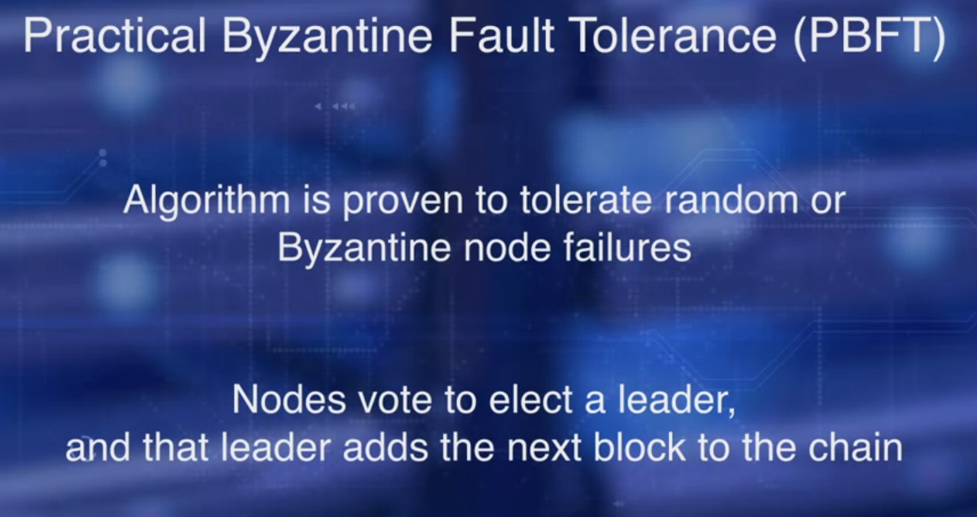
Course 4: Week3, Challenges & Solutions (PBFT)
Practical Byzantine Fault Tolerance, PBFT.
This algorithm is proven to tolerate random or Byzantine node failures, including malicious nodes.
In PBFT, nodes vote to elect a leader c and that leader adds the next block to the chain. This is the block of validated transactions.
Each node maintains the state of the network.
The nodes exchange messages.
The messages, along with the saved state, are used to reach a consensus in the presence of random independent faults, or bad nodes. The chosen node adds the next block of validated transactions.
PBFT is popular in permissioned block chains, such as hyperledger fabric.
Later in the course, we'll learn an emerging consensus algorithm called Hashgraph that is a variation of Byzantine fault tolerance. It is called asynchronous Byzantine fault tolerance, or ABFT.

Slide 47
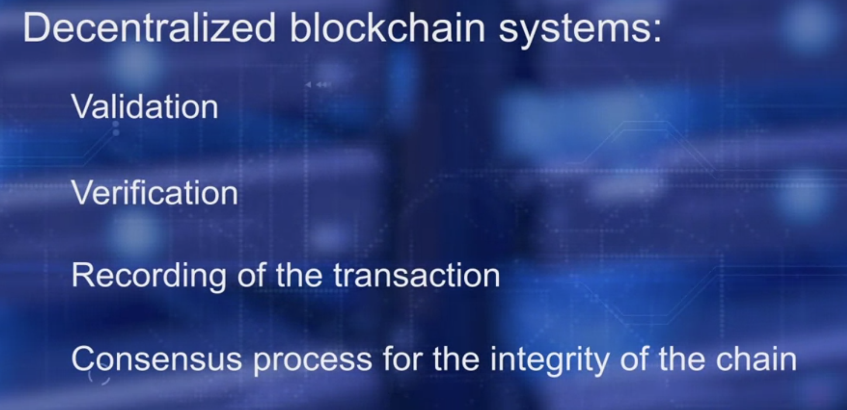
Course 4: Week3, Challenges & Solutions (Scalability)
Let's compare decentralized blockchain systems with centralized systems.
Blockchain has taken on the responsibility of the intermediaries in the form of validation, verification, and recording of the transactions, and of course, the consensus process for the integrity of the chain. All these functions take time and result in significant overhead in the confirmation time of transactions, when compared to the centralized system.
Every full node stores the entire chain of blocks. All these impede the scalability of the blockchain applications. Transaction rates are not satisfactory compared to current centralized application.

Slide 48
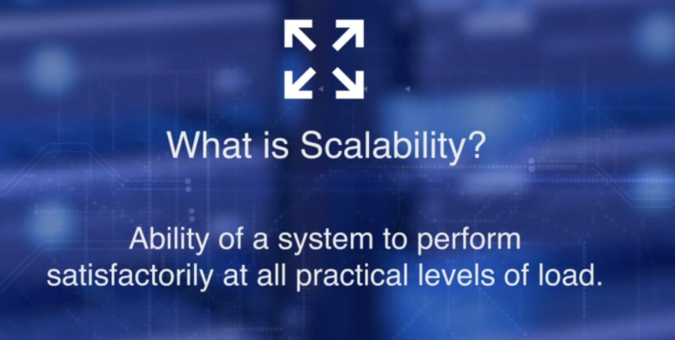
Course 4: Week3, Challenges & Solutions (Scalability)
Scalability is the ability of a system to perform satisfactorily at all practical levels of load.
Load in the context of the blockchain could be transactions, number of nodes, number of participants and accounts, and other attributes of blockchain. In the case of blockchain, the practitioners are concerned about the transaction rate or transactions per second.
This is a critical metric for many applications from payment system to supply chain management to perform well.

Slide 49
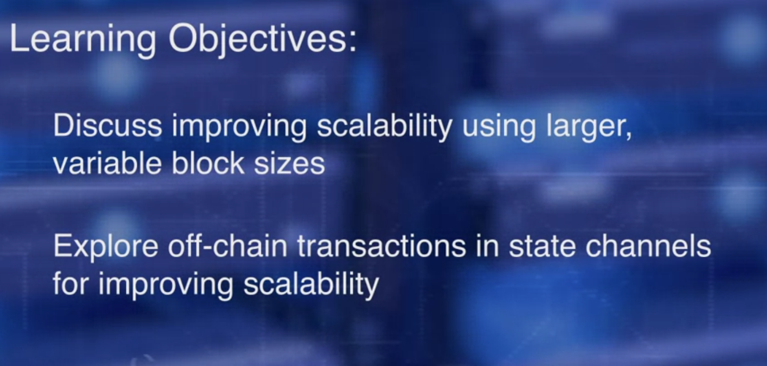
Course 4: Week3, Challenges & Solutions (Scalability)
On completion of this lesson, you will be able to: discuss
an on-chain solution in improving scalability using larger variable block sizes, and explore off-chain transaction in state channels for improving scalability.
The most obvious method to improve transaction rate is to increase the number of transactions per block. Bitcoin addressed it in two ways, segregated witness and increase in block size limit.

Slide 50
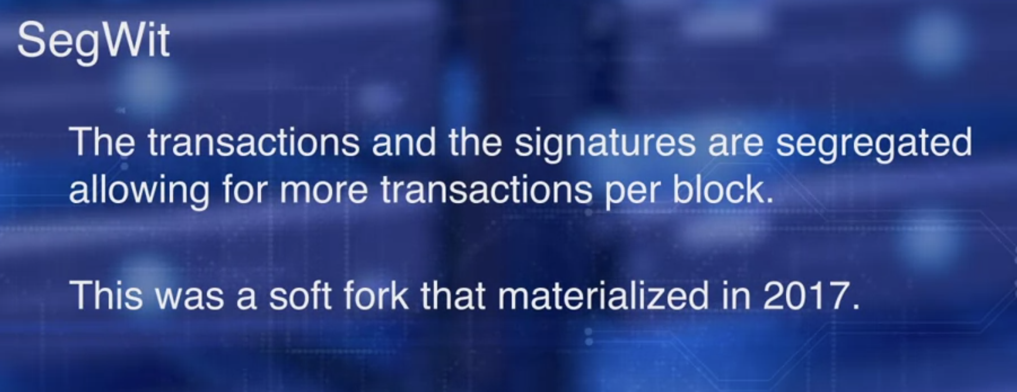
Course 4: Week3, Challenges & Solutions (SegWit)
In segregated witness or SegWit, the transactions and the signatures are segregated for allowing for more transactions per block.
This was a soft fork that materialized in 2017. It's working in the current version of the Bitcoin blockchain. However, the current version, the block size limit is fixed at one megabyte.

Slide 51
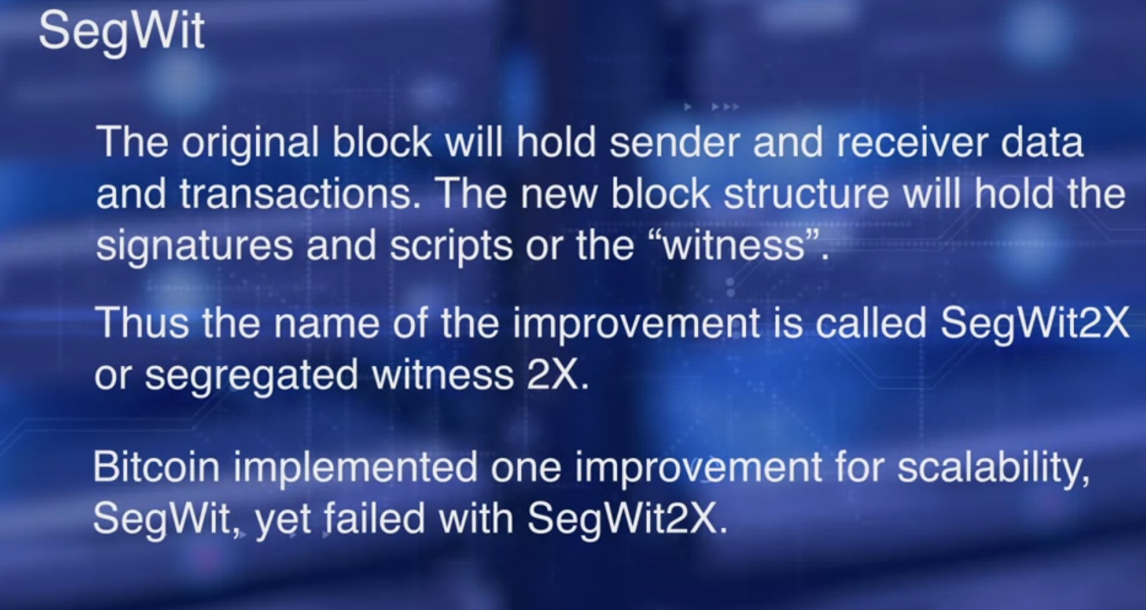
Course 4: Week3, Challenges & Solutions (SegWit)
The second proposal for scalability was to increase the block size limit to a larger size of two megabyte.
In this case, the original block will hold the sender and receiver data and transactions, the new block structure will hold the signatures and script, or the witness. Thus, the name of the improvement is called Segret2X, or Segregated Witness 2X.
It was a planned hard fork that was to have taken place in November 2017, but did not go through. At this time, Bitcoin has implemented one of its improvement for scalability namely the Segret, it failed with Segment 2X.

Slide 52
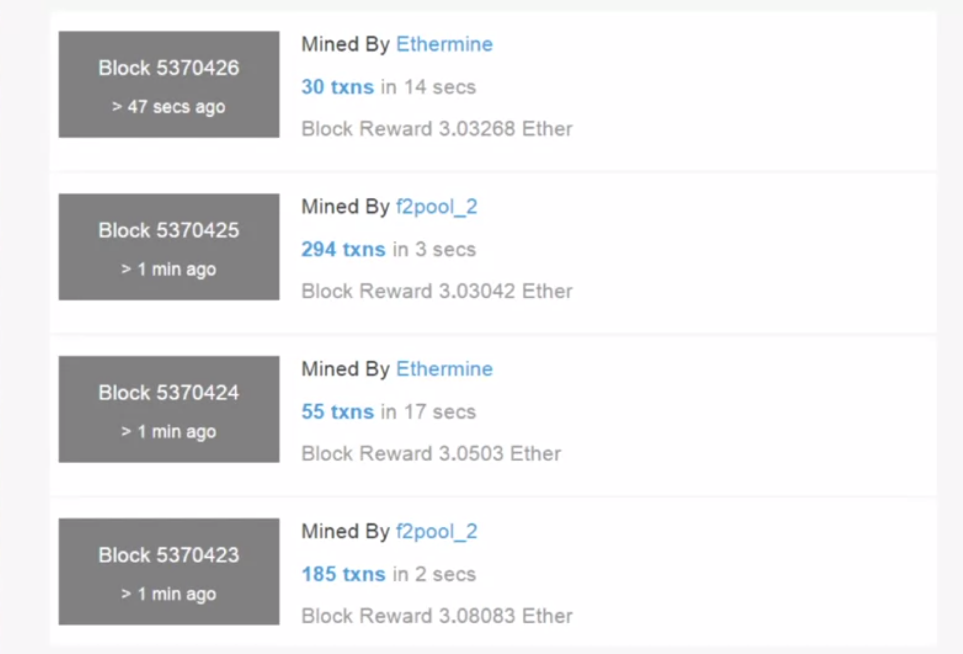
Course 4: Week3, Challenges & Solutions (ETH)
In Ethereum, block size can vary, and is limited by the gas limits specified in the block header.
It can be increased by miners working on it. The number of transactions in a block dictates the block size. Here, we see four blocks mined with 30 transaction, 294 transaction, 55 transactions and 183 transaction with the average block time of eight seconds.
This variable block size along with ASIC-resistant Pure W Consensus Algorithm have improved the transaction rate.
It is expected to improve further when Ethereum moves to proof of
state Consensus Protocol in an upcoming hard fork in 2018.

Slide 53
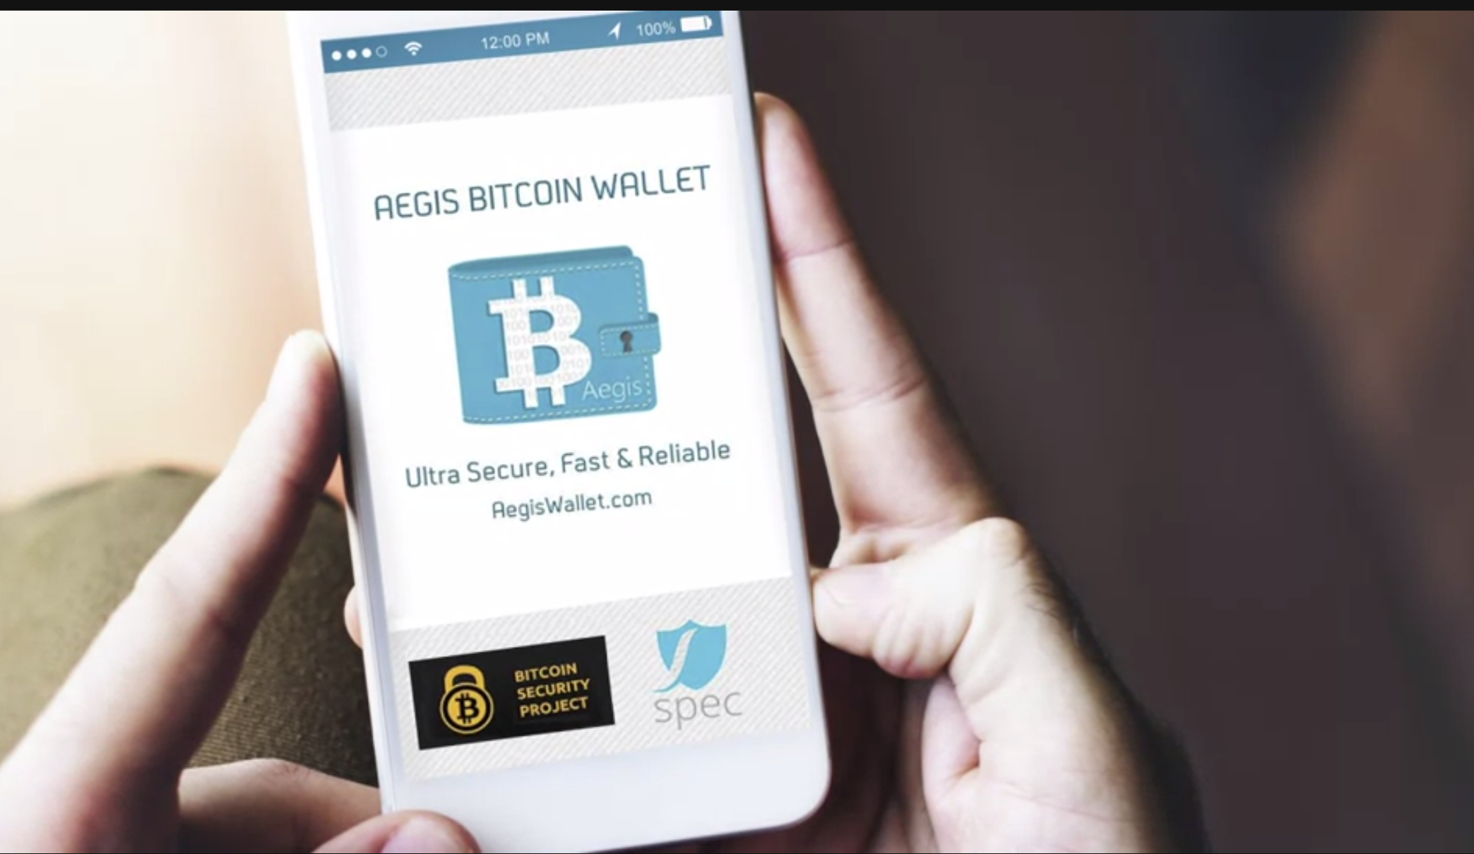
Course 4: Week3, Challenges & Solutions (Off-Chain)
One of the solutions to address transaction rate is to unload some of the transactions off-chain. This is carried out between trusted transacting parties. Once the unload has concluded, a transaction confirming this off-chain activity is recorded on-chain on the blockchain DLT.
This feature in Bitcoin is called payment channel. Payment transactions can be carried out with minimal fees at considerable higher rates between trusted parties. This leverage is the Segret improvement we discussed earlier.
Lightning network is a well known blockchain implementing this protocol.
An Ethereum solution extends this payment channel concept to Smart Contracts. The state channels are an extension of the payment channel concept to any arbitrary application level transaction. It is called the State Channel since the state of a node on the main chain is locked when transacting off-chain, and it is synchronized periodically with relevant updates on the main chain.
The transaction of off-chain channels take place at much higher speeds than the blockchain network since no consensus or recording under DLT is required.
Thus, offering a scalable solution.
The popular grid plus energy platform uses this off-chain payment channel for real-time energy payments from a Smart Contract to the grid plus retailer Smart Contracts.
In this case, there is a one to one trusted transactions between two known parties that have secure channel pre-established.

Slide 54
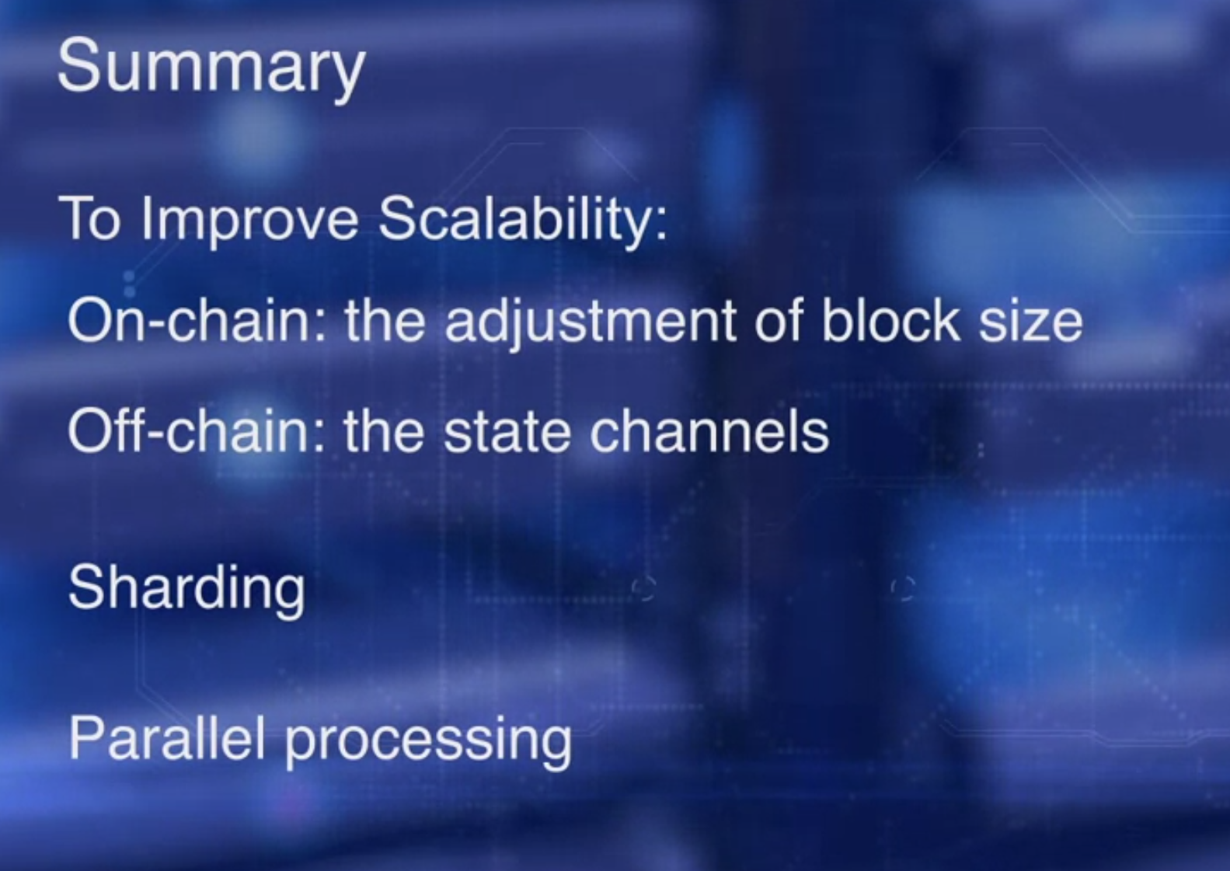
Course 4: Week3, Challenges & Solutions

Slide 55
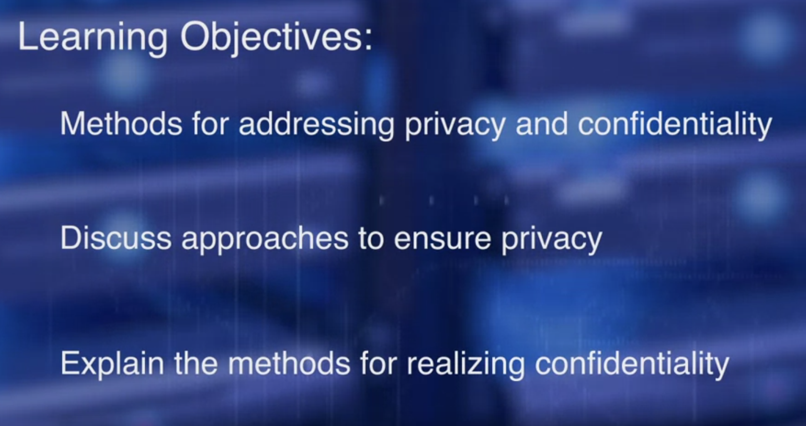
Course 4: Week3, Privacy & Confidentiality
Privacy is the right to protect the data, attributes,
and assets of an entity from observation by unconsented parties.
Confidentiality of data ensures that only authorized entities can have access to the data. These are two important concept especially for blockchain where
the transactions can be viewed and analyzed using custom-built tools.

Slide 56

Course 4: Week3, Privacy & Confidentiality
You can see all the transactions happening on the Bitcoin blockchain.
Many blockchains including Enterprise Ethereum and Hyperledger Fabric are permissioned blockchains.
They limit access to the blockchain to permission entities only.
This ensures privacy of the network to a large extent. Within the network, data access privileges such as create, read, update are assigned to various entities. These are enforced with every transaction.
This adds to the basic privacy provided by permissioned networks. Some blockchain platforms such as MultiChain ensures that the transacting nodes are indeed in a permissioned list.
It also authenticates the sender and receiver using key exchange for every transaction.

Slide 57


Course 4: Week3, Privacy & Confidentiality
For confidentiality, a straightforward method is to encrypt the data transacted and digitally sign it. It is also possible to obfuscate the data by adding extra elements. We illustrate the encryption and obfuscation with a smart contract data, blindedBid, where the actual bid in a blind auction smart contract is the value, but we've added two more parameters called fake and secret.
In this case, the blindedBid sent by the bidder is obfuscated with the value fake and a value secret as parameters, and then encrypted with keccak secure hash algorithm.
This provides confidentiality of the bid in a blind auction application. We explored at high level some simple methods for ensuring privacy and confidentiality.

Slide 58

Course 4: Week3, Multisig & Escrow
Escrow and multisig are two techniques that have enormous potential in addressing business contract related issues to transform business processes.
On completion of this lesson, you will be able to explain, the features of escrow within smart contact and features of multisig.
A smart contract can do all this. It can hold money and all artefacts in an escrow, and allow transacting parties to negotiate on it, and verify conditions to be met before the disbursement of the items in the escrow.
What is innovative is that, it can be done among parties that are operating beyond boundaries of trust in a decentralized world. Recall that a smart contract has an address that can hold a balance.

Slide 59

Course 4: Week3, Multisig & Escrow
Recall grid platform. Grid place energy application platform users, replenish both coins as a deposit escrow in the smart contract agent, that is used for payment conditional on the energy expended by the user.
Based on the energy consumption, the smart agent sends only the payment for this consumption to the grid place retailer. Grid place business model also requires a monthly deposit by the consumer.
In case, the smart agent runs out of bonds for the payment of energy consumption, the additional amount is deducted from the escrow.
This is another use of smart contract escrow. It helps avoid interruption in electricity service. Holding escrow funds commonly works in conjunction with multiple signatures

Slide 60

Course 4: Week3, Multisig & Escrow
Bitcoin has an alternative to a single key address.
This is defined by the type of address.
This is defined by a type of address called pay to script hash, a multisig address. Multsig addresses in the bitcoin transactions begin with the digits three, whereas regular addresses begin with the digit one.
A pay to script hash address can support a set of n keys,
any of m which are required to transact m of n. In practice, most multisigs are two out of three, two out of two, though larger values of m and n can be used for such use cases as legal documents.

Slide 61

Course 4: Week3, Multisig & Escrow
How do you use multisig?
Generate a multisig address, it has n number of keys, m of which are required to trigger an action. Then fund the new multisig address with a deposit. Now, you're ready to transact. Create a multisig transaction.
This transaction will be signed with the first signature ms one, resulting in the hex string, hs one.
Then they can be signed by the second signature ms two, resulting in hex string hs two. This is repeated m times for the m signature resulting in hsm. This is the required multisigned key. It is verified by the protocol and the funds are transferred. This explains the multi-sig operation.

Slide 62

Course 4: Week3, Multisig & Escrow

Slide 63

Course 4: Week4, Alternative Decentralized Solutions

Slide 64

Course 4: Week4, Alternative Decentralized Solutions Interplanetary File System
Interplanetary Files System, IPFS, is a fine example of such a system.
IPFS is a decentralized model for file transfer in contrast to centralize namespace and transfer provided by HTTP family of protocols.
Juan Benet, the creator of IPFS, described IPFS it is whitepaper as Content Addressed, Versioned, P2P file

Slide 65


Course 4: Week4, Alternative Decentralized Solutions Interplanetary File System

Slide 66

Course 4: Week4, Alternative Decentralized Solutions Interplanetary File System
This is the high level view of the architecture of IPFS. Files are located in a distributed system. A distributed hash table maintains a location of the files.
Application use the hash as the key in the DHD that returns the location of the file. Once the location of the file is determined, the peer-to-peer transport takes place.
The nodes of computers that hold the decentralized file objects that formed the global file system. They hold the objects that formed the files to be exchanged. Nodes are identified by cryptographic hashes of its public key.
This is similar to our blockchain nodes. File objects are identified by a secure hash and any object may contain sub-objects, each with its own hash that is used in the creation of the root hash of the object.

Slide 67
Course 4: Week4, Alternative Decentralized Solutions Interplanetary File System
Recall the Merkel Tree from course one, the blockchain basics?
In the current world wide web protocol, we typically refer to a web resource or a data by the server on which they are stored.
For example, https://www.coursera.org/ actually refers to the server on which the Coursera page is hosted, and to a particular directory and file on that server.
This is a centralized approach. What if the resources are available in a number of distributed locations?
IPFS offers a decentralized solution for this. Then, how does IPFS identify the resources?
Well, hash of course. Instead of identifying the resource by its location as an HTTP, IPFS identifies the resource by its content or by the secure hash of its contents. In this case, the file is addressed by a universally unique identifier instead of by its location.

Slide 68

Course 4: Week4, Alternative Decentralized Solutions Interplanetary File System
IPFS is a decentralized file system like a BitTorrent-powered web. You find files using their unique hash, and nodes holding the data exchange blocks through a "barter" system driven by "bit swap". Versions of files are tracked using a special data structure, and IPFS can work both standalone and with blockchains for decentralized storage of large datasets.
Key points:
Decentralized file system: No central server, nodes share files peer-to-peer.
Hash-based lookup: Find files by unique identifier.
Bit swap protocol: Nodes exchange file blocks through a "want & have" bartering system.
Merkle DAG: Tracks file versions efficiently and prevents duplication.
Standalone or with blockchain: Can be used independently or store large data for blockchain applications.

